Slide 1
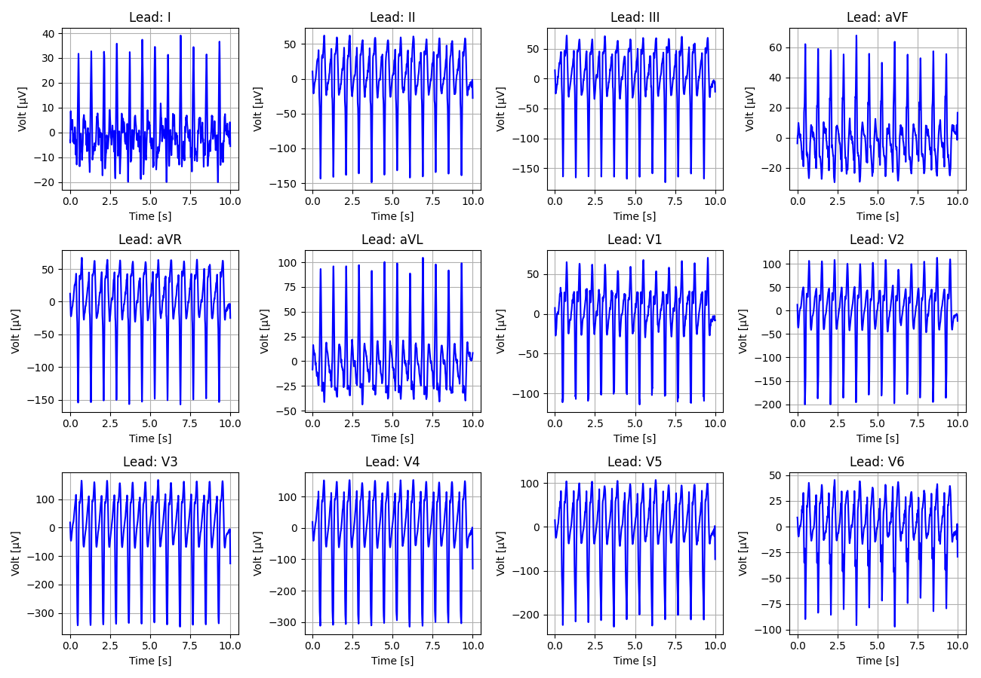
1_Recording_2462572

Slide 2
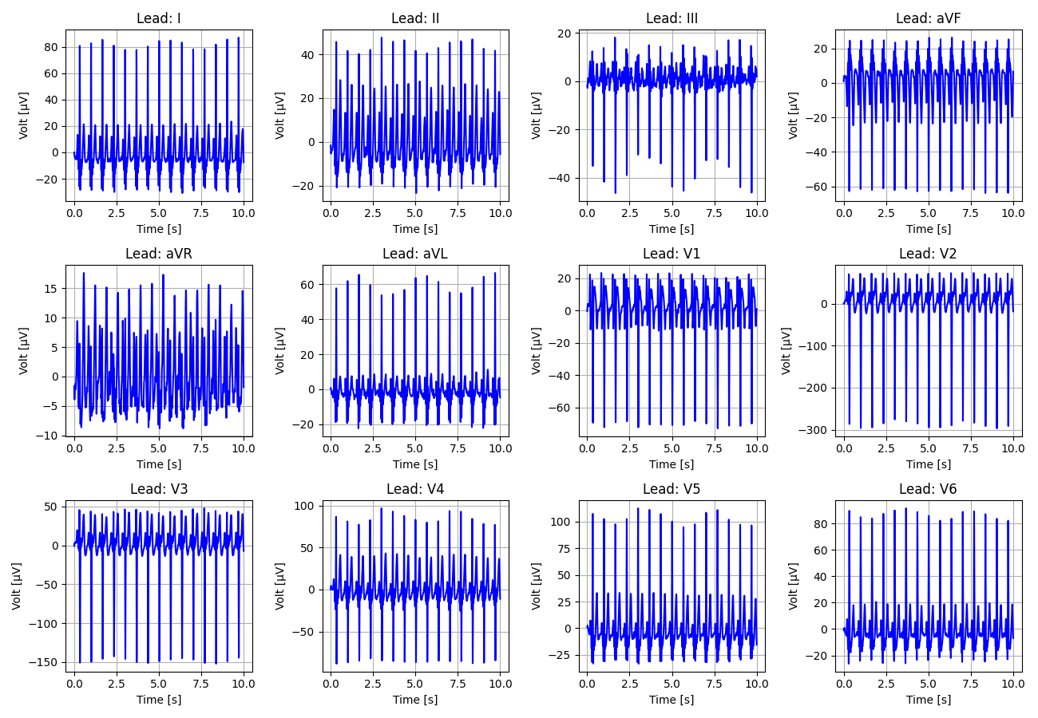
2_Recording_1369340

Slide 3
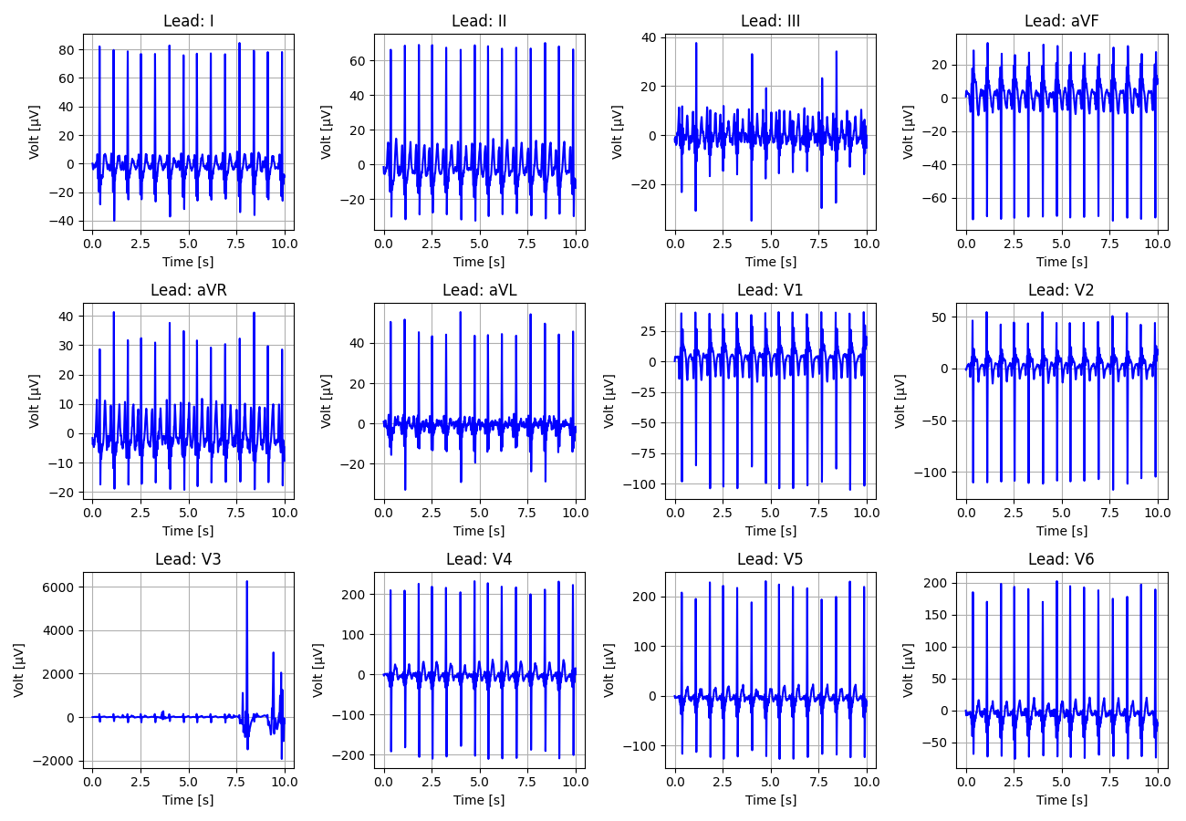
3_Recording_2705121

Slide 4
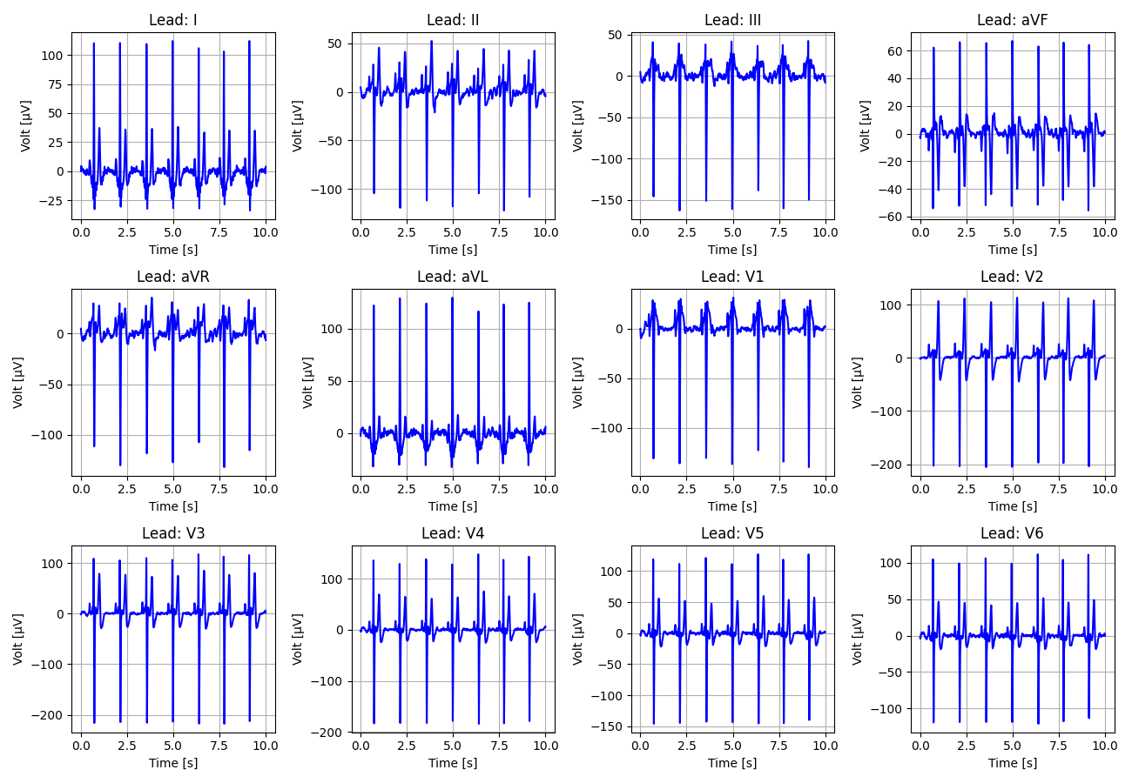
4_Recording_2126232

Slide 5
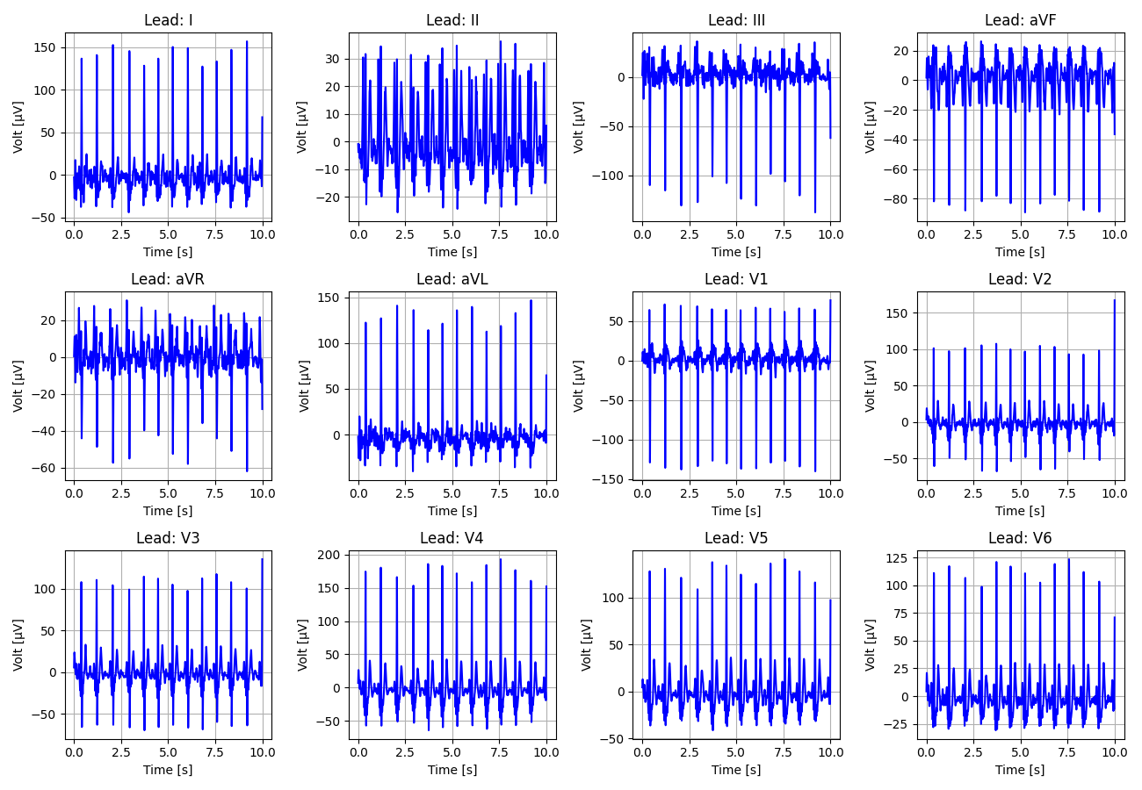
5_Recording_2050741

Slide 6
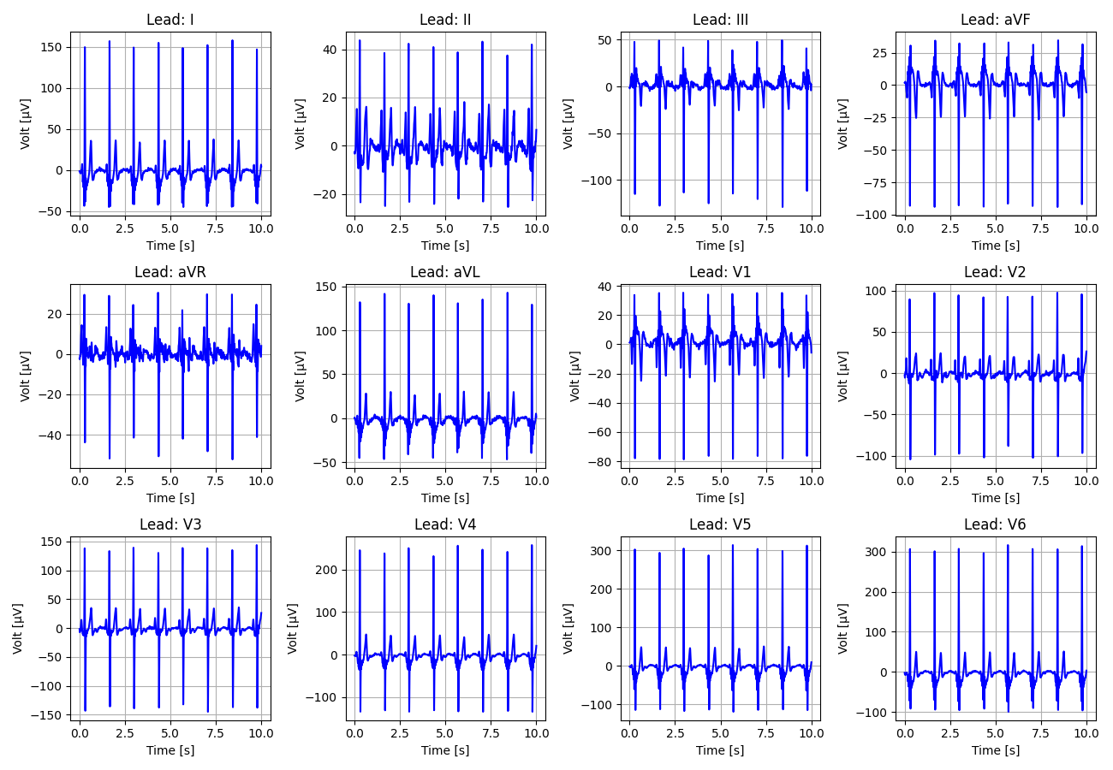
6_Recording_2169603

Slide 7
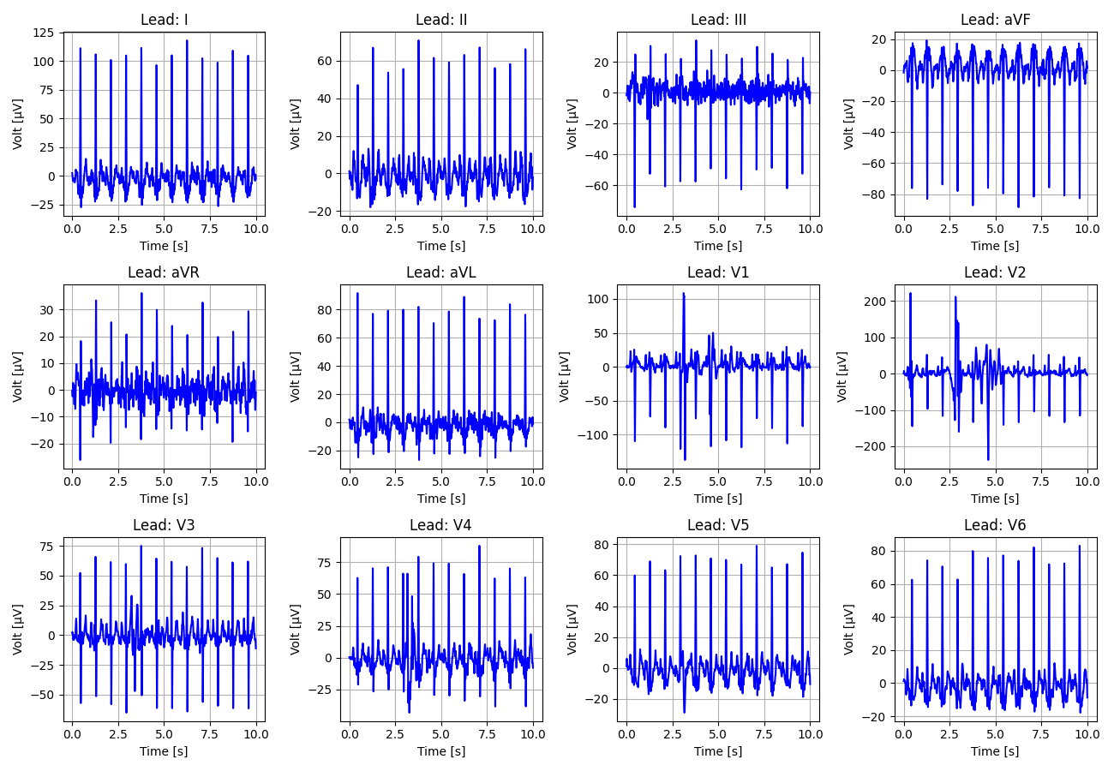
7_Recording_2028227

Slide 8
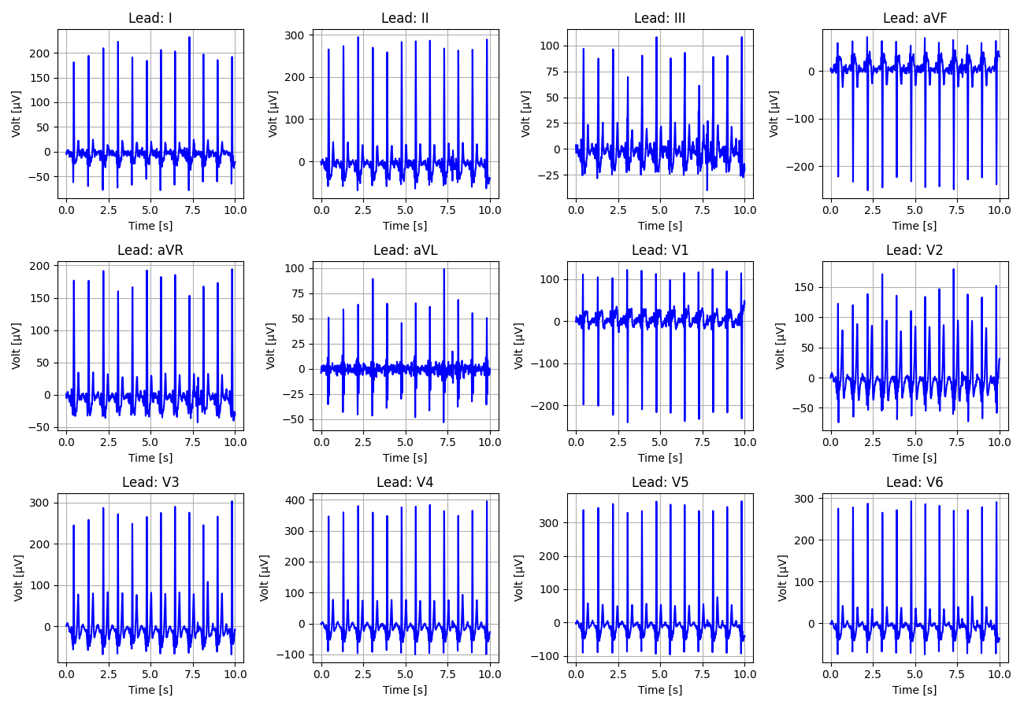
8_Recording_1836357

Slide 9
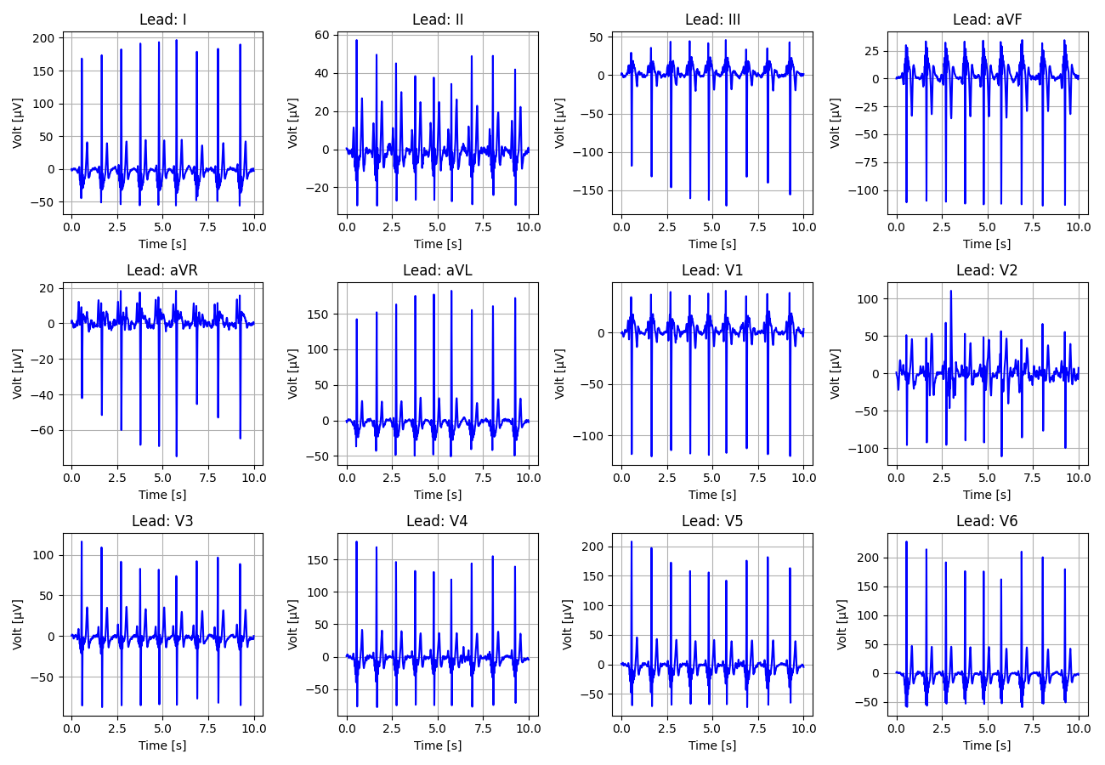
9_Recording_1652924

Slide 10
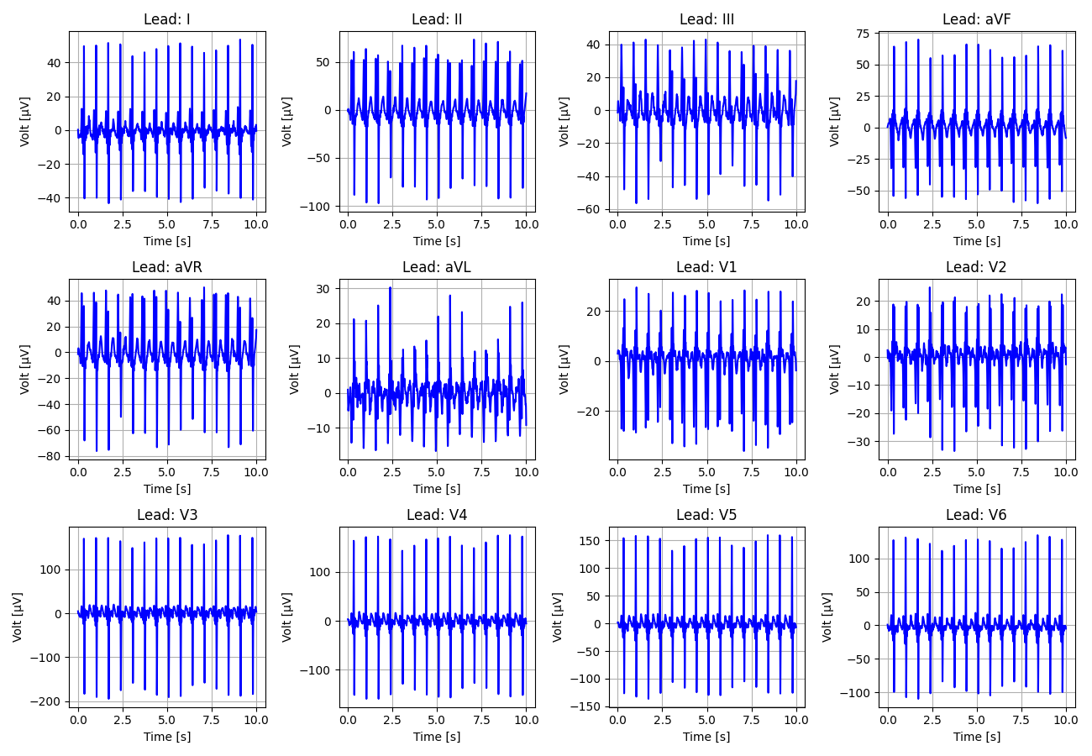
10_Recording_1308563

Slide 11
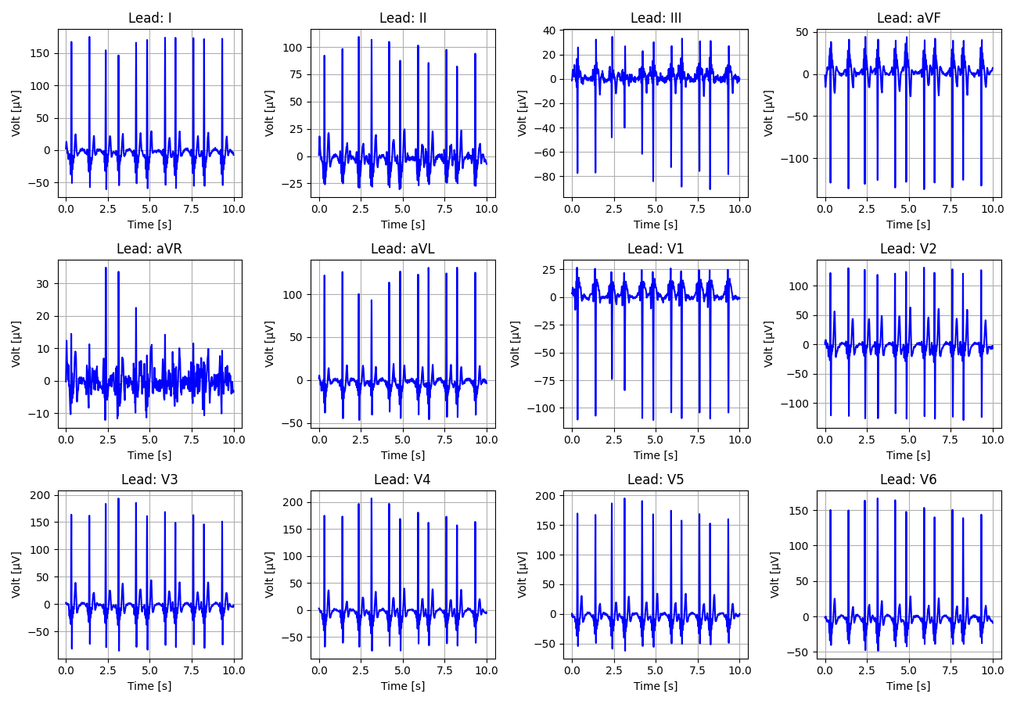
11_Recording_2932791

Slide 12
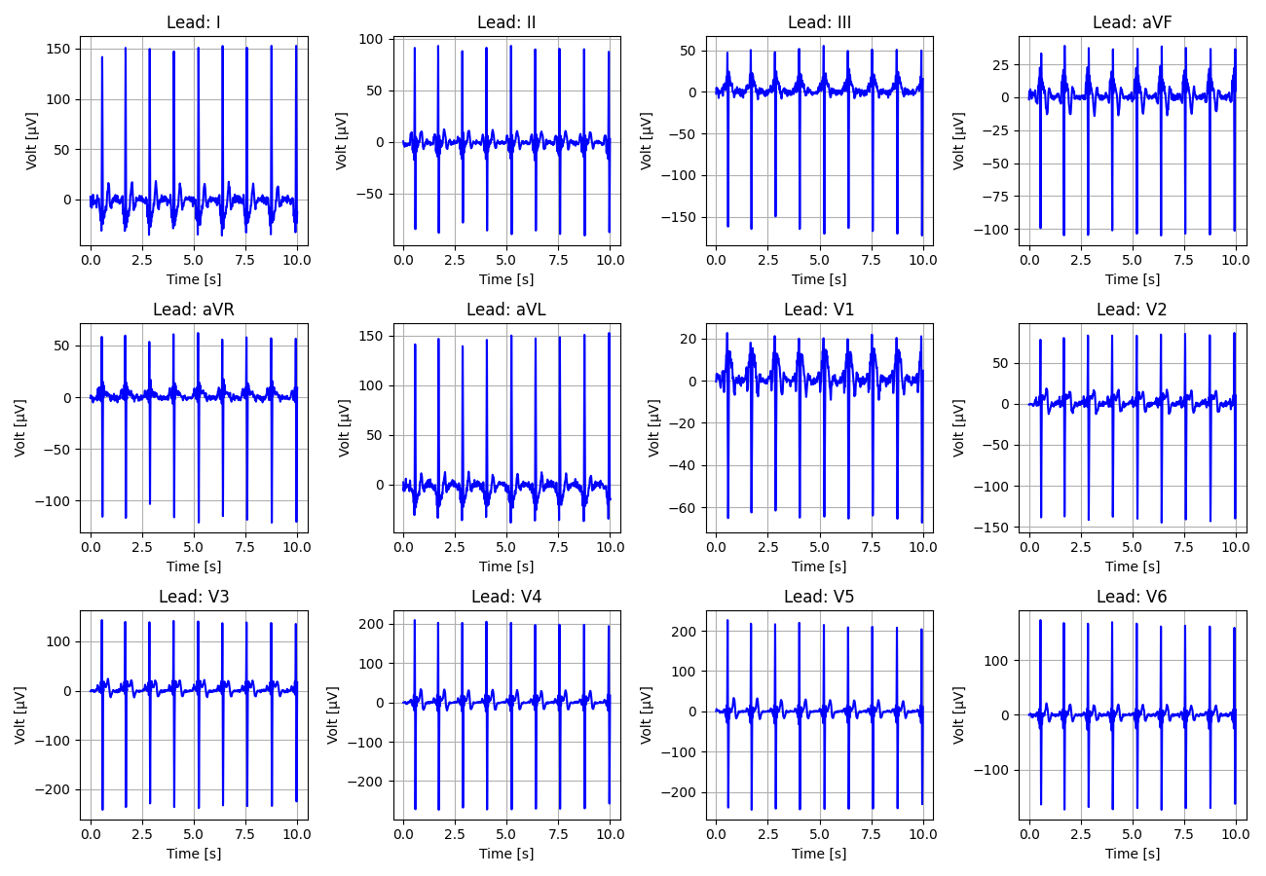
12_Recording_2615913

Slide 13
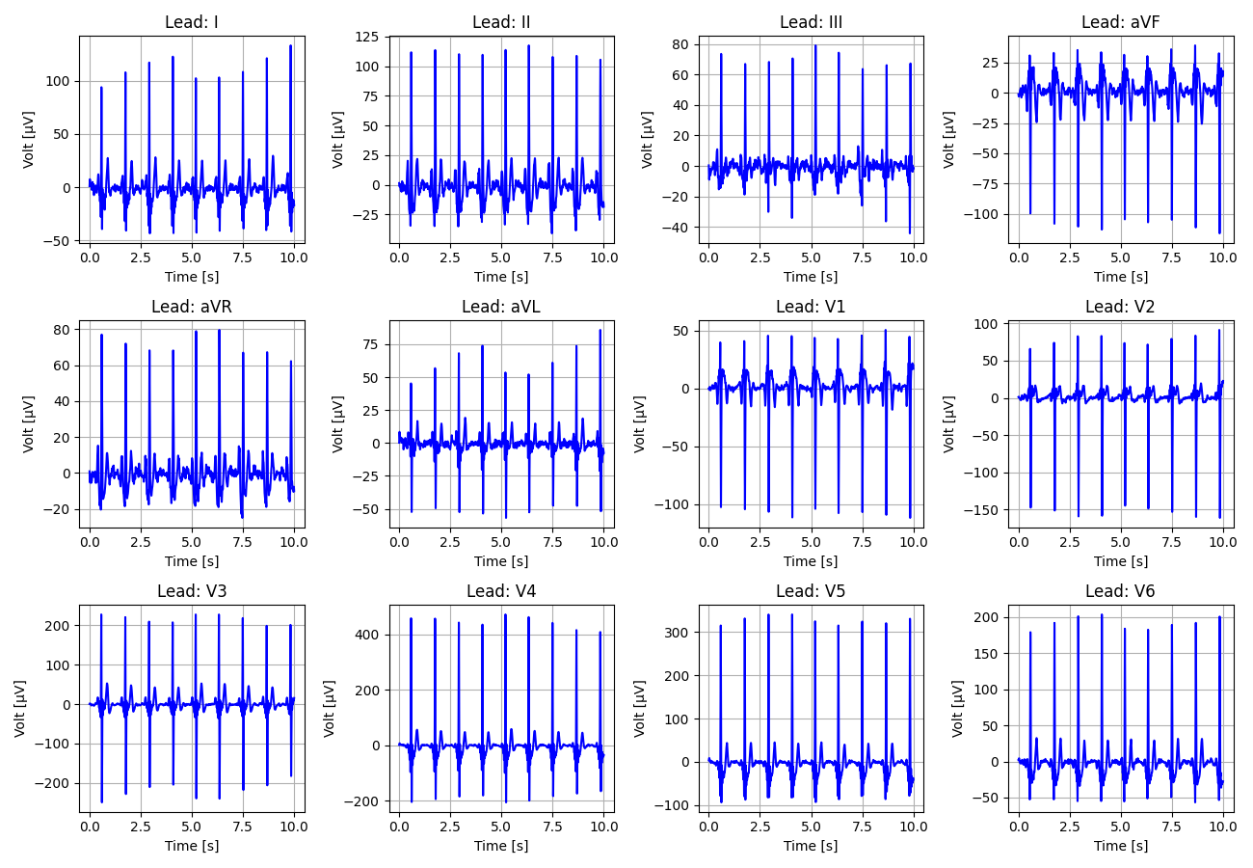
13_Recording_1601254

Slide 14
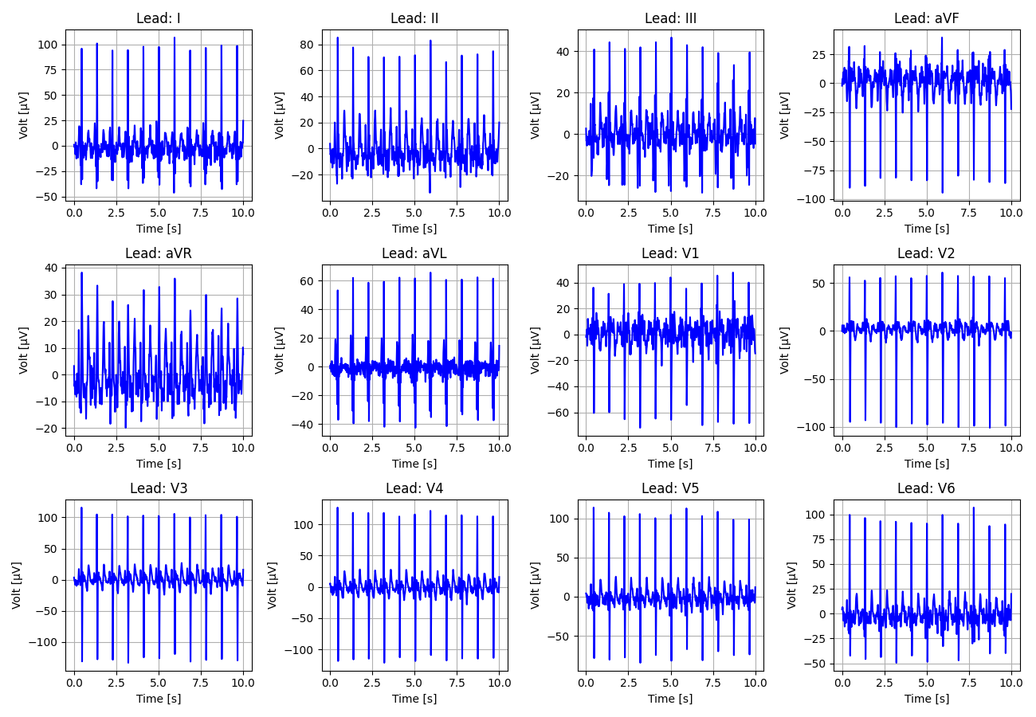
14_Recording_2878973

Slide 15
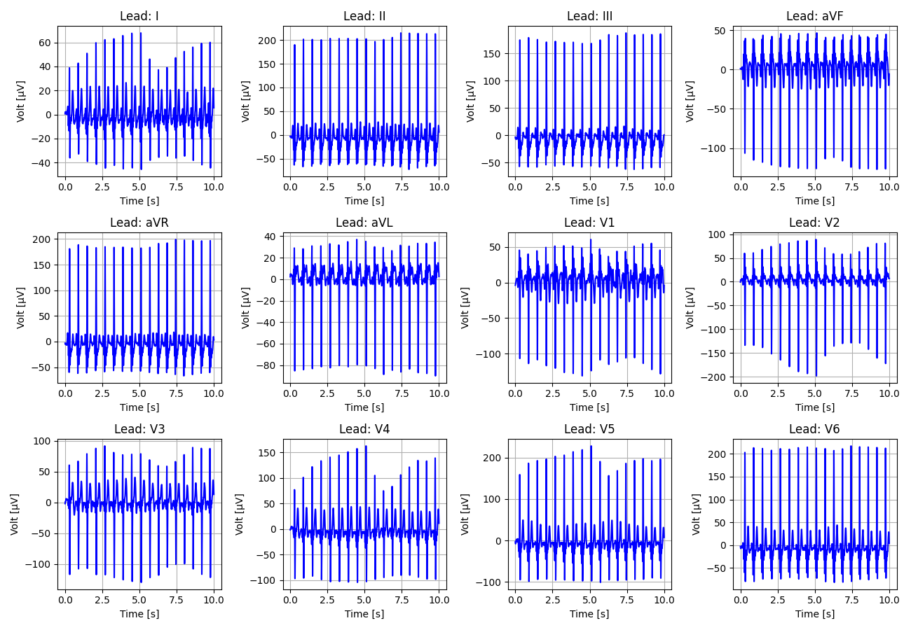
15_Recording_2622365

Slide 16
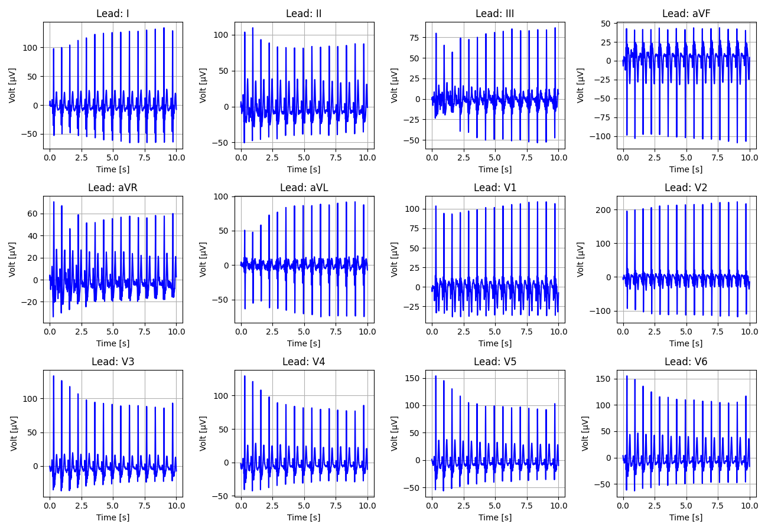
16_Recording_2295527

Slide 17
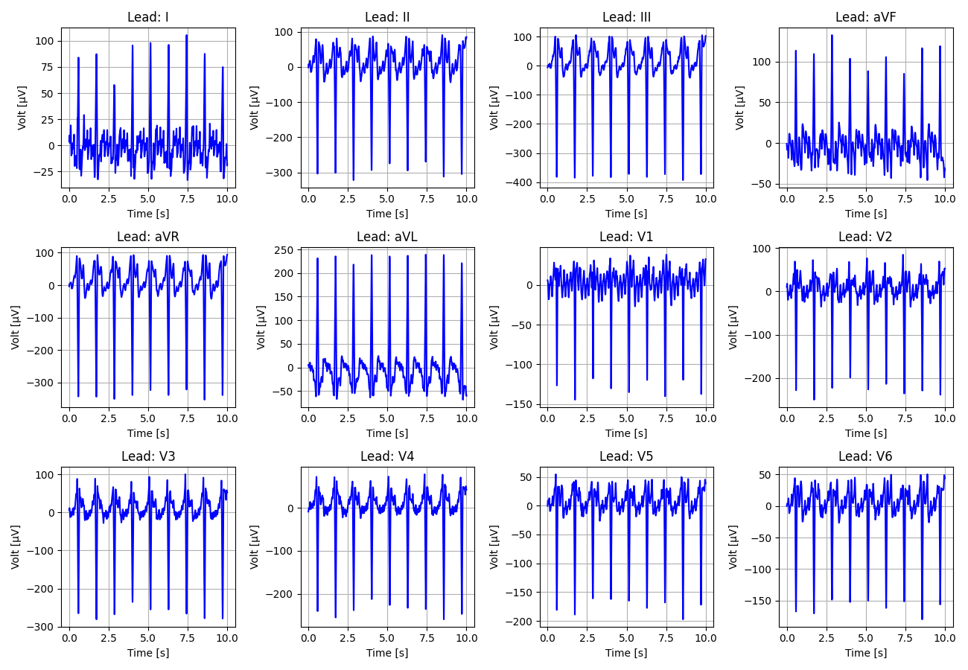
17_Recording_1320361

Slide 18
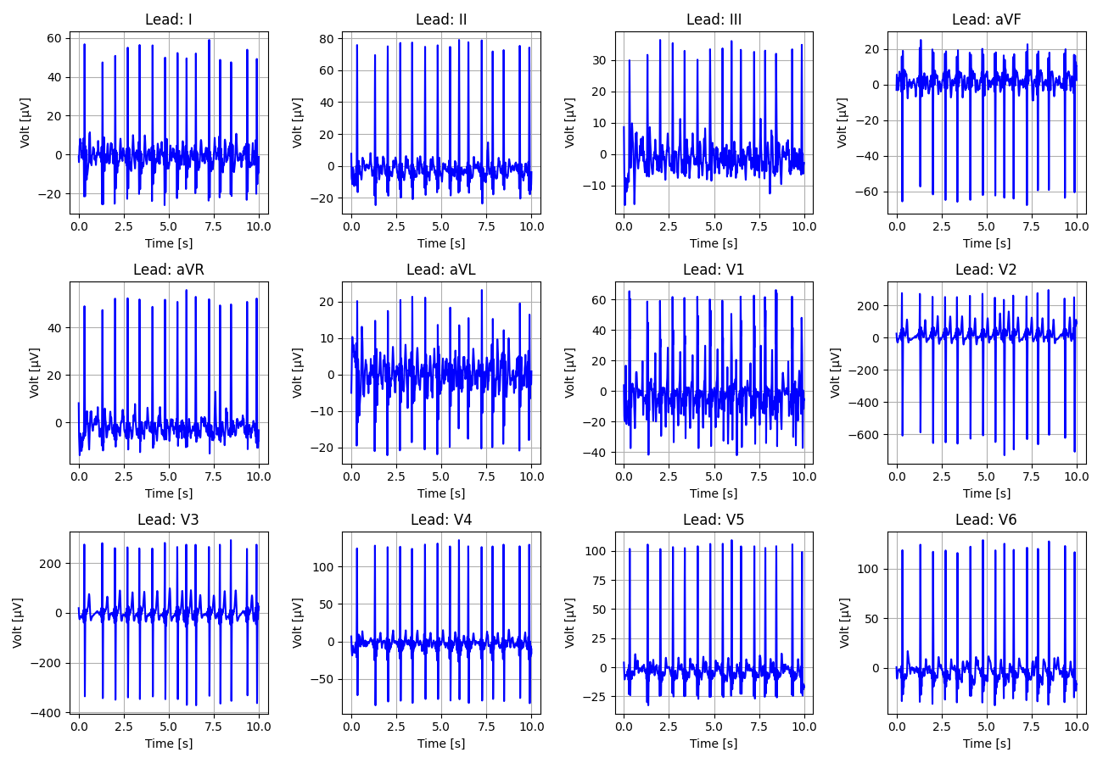
18_Recording_2496130

Slide 19
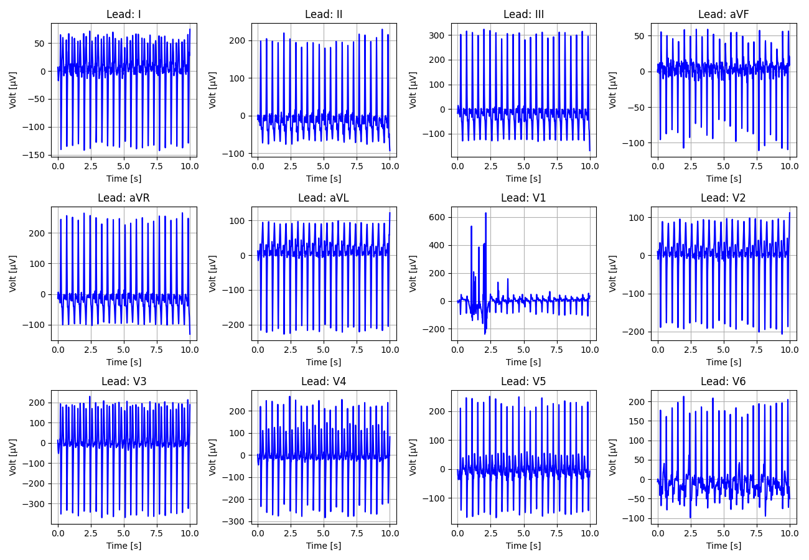
19_Recording_2803209

Slide 20
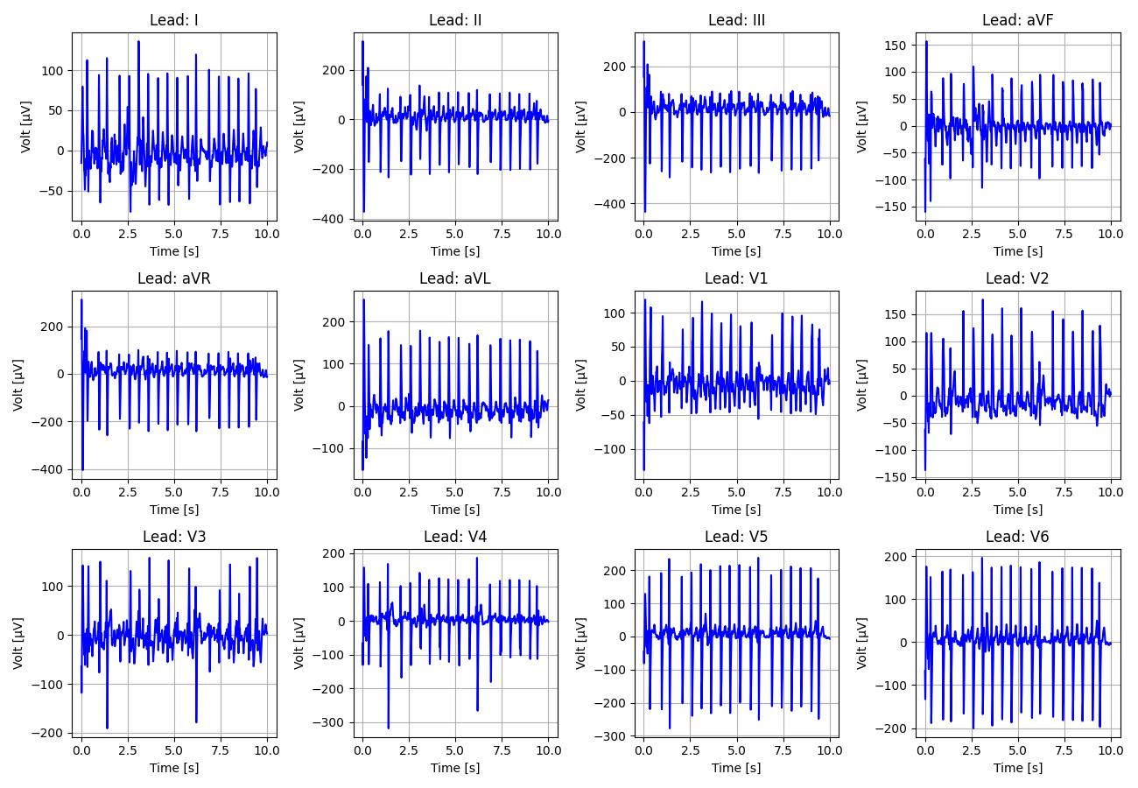
20_Recording_1578908

Slide 21
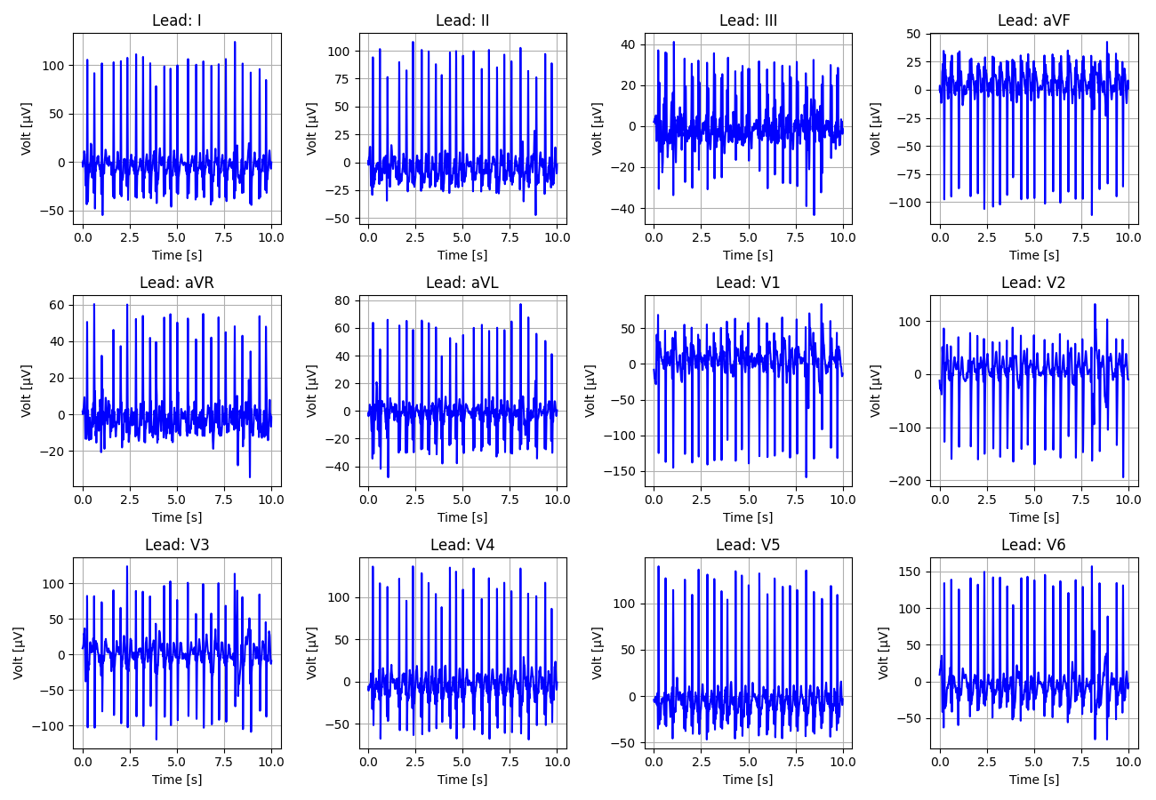
21_Recording_2482938

Slide 22
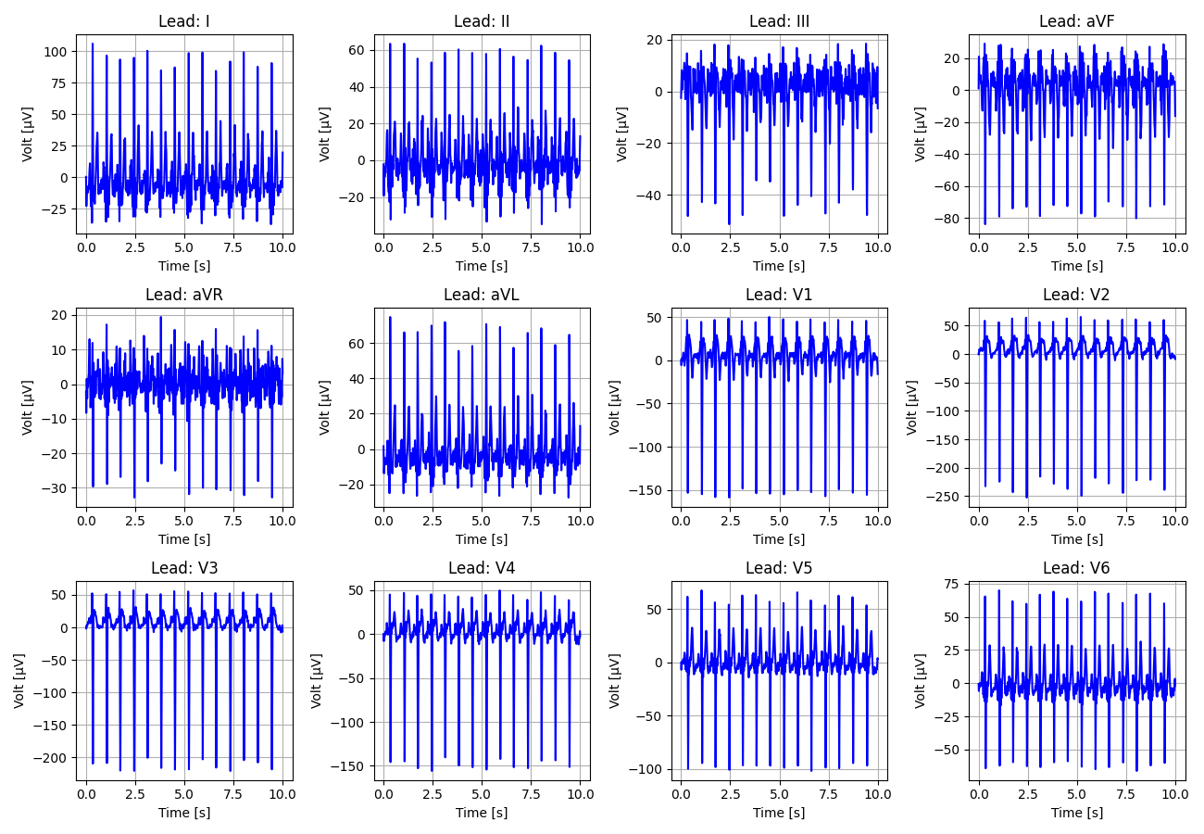
22_Recording_1741864

Slide 23
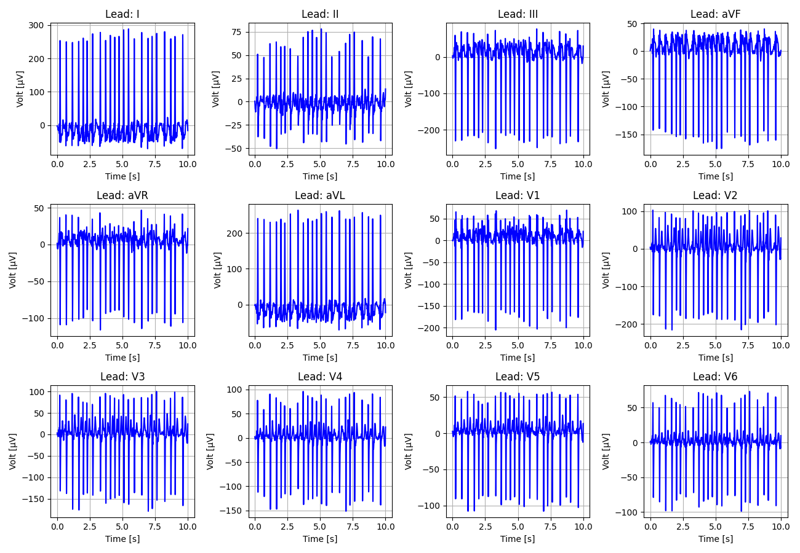
23_Recording_1413908

Slide 24
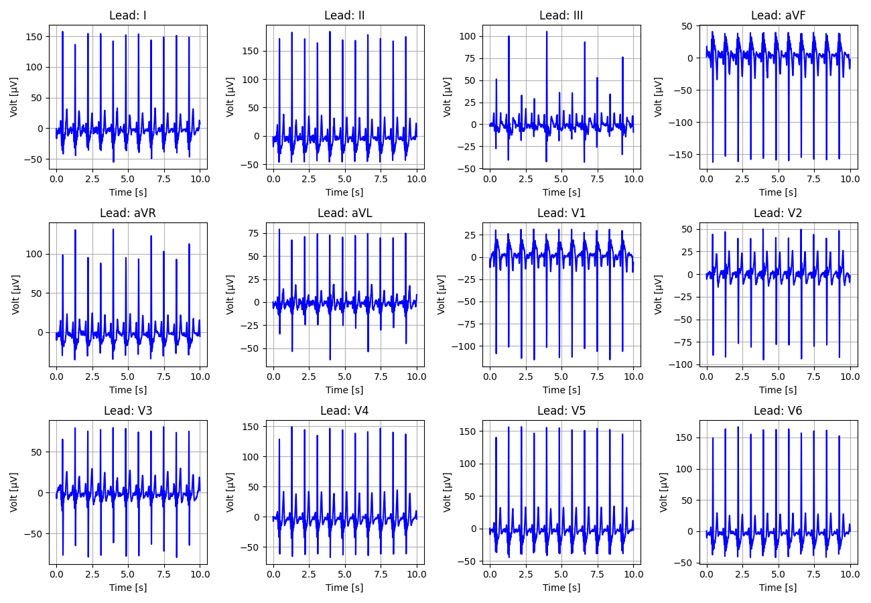
24_Recording_1735742

Slide 25
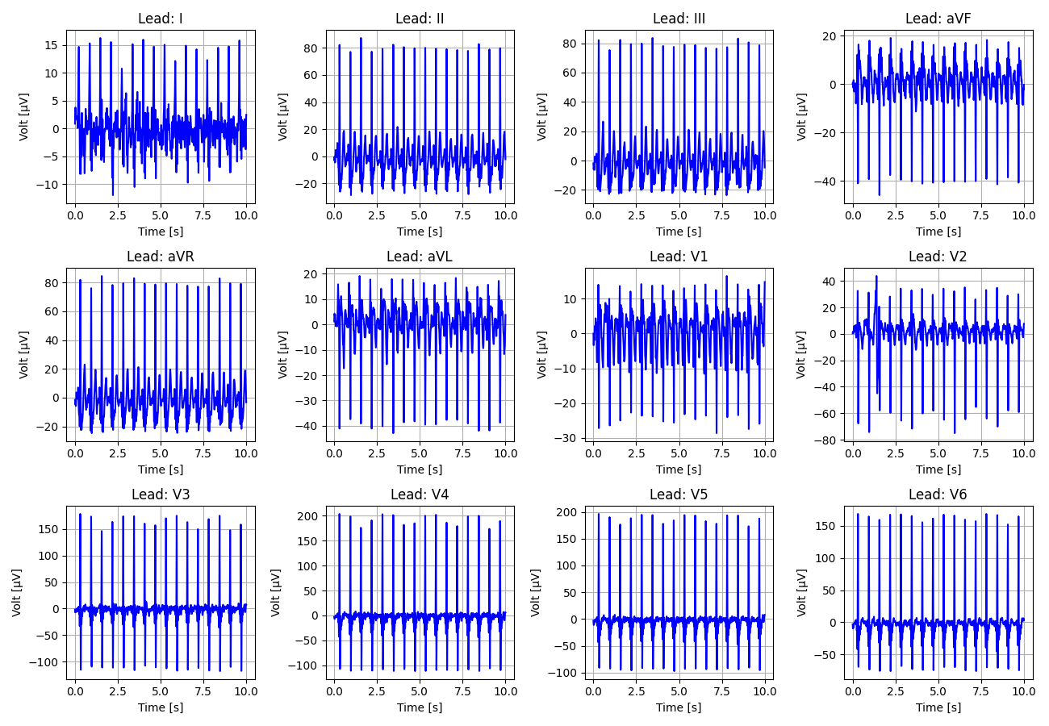
25_Recording_1685808

Slide 26
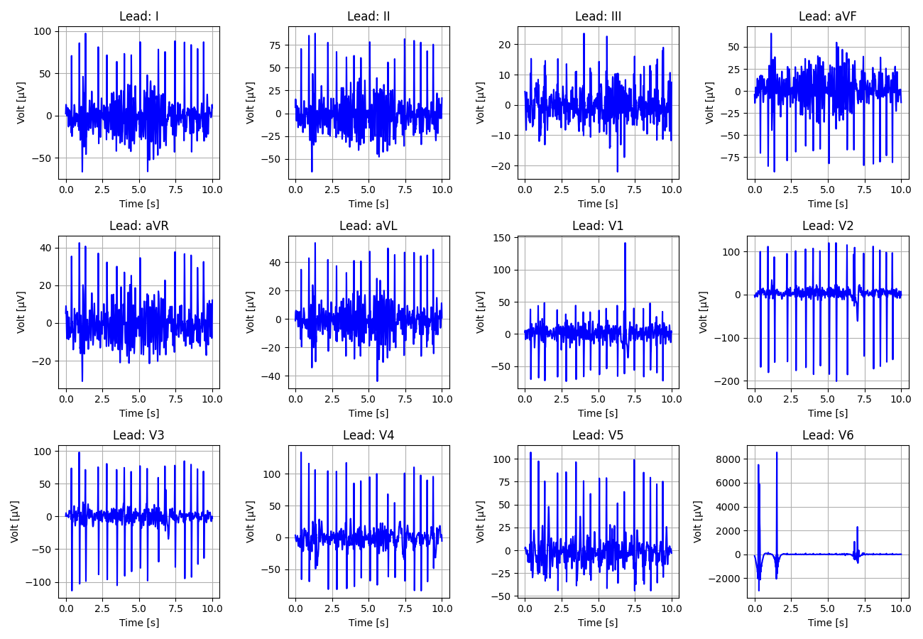
26_Recording_2651374

Slide 27
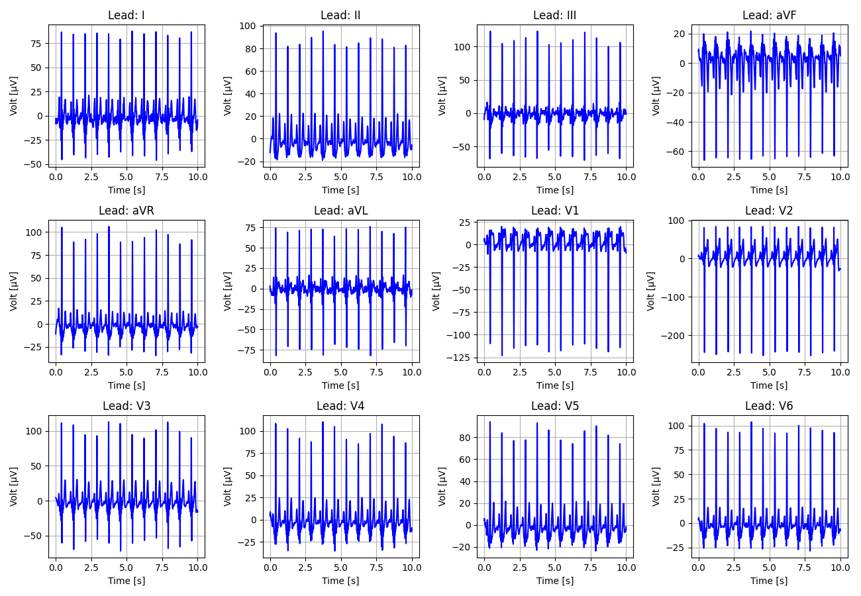
27_Recording_2086672

Slide 28
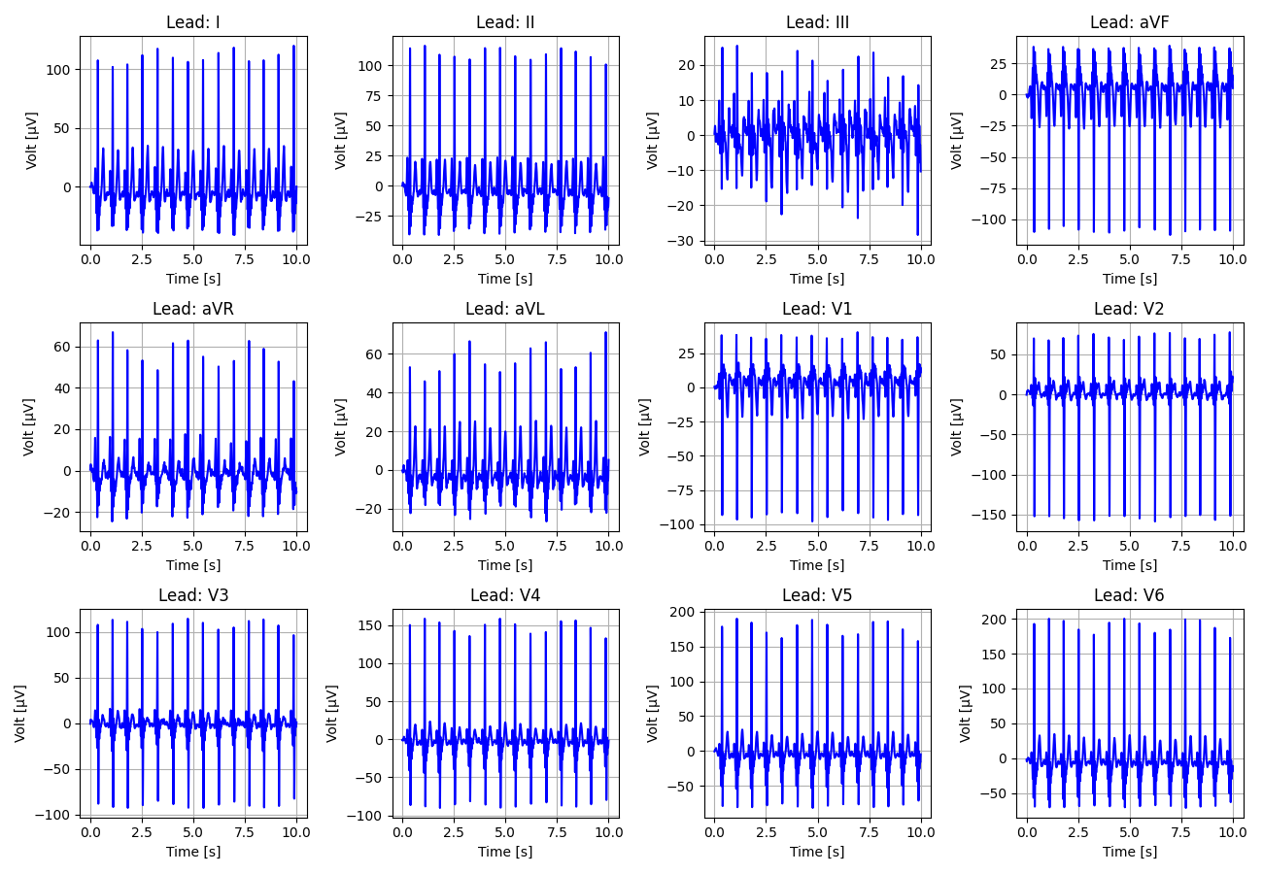
28_Recording_2711879

Slide 29
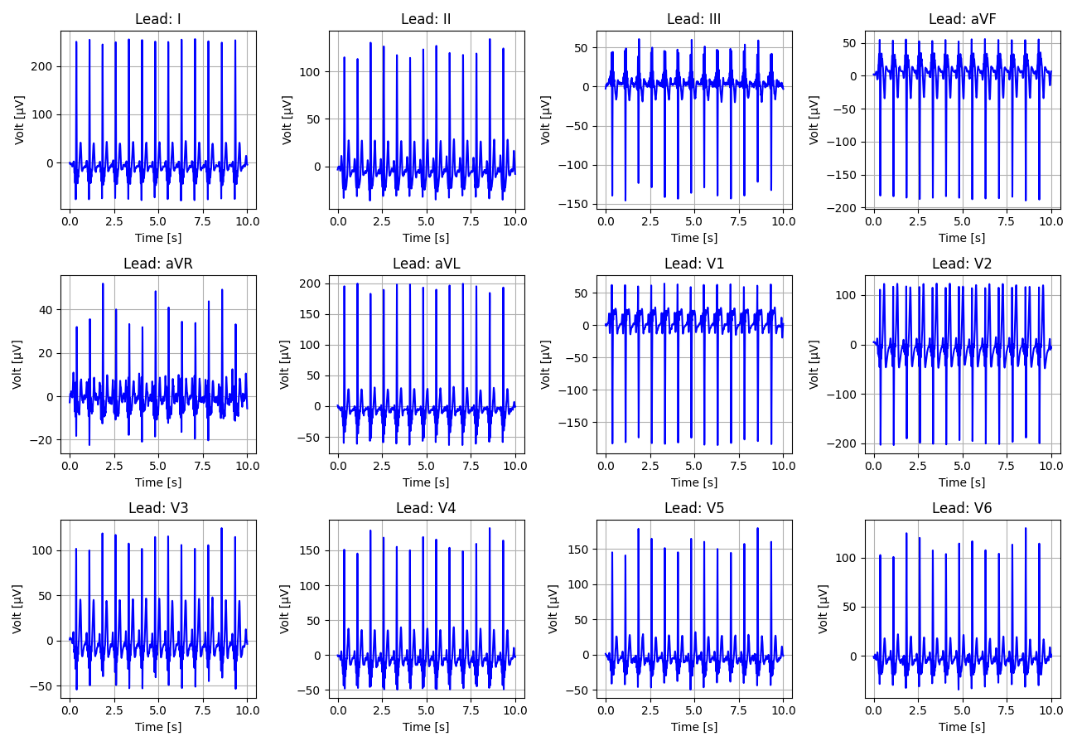
29_Recording_2480414

Slide 30
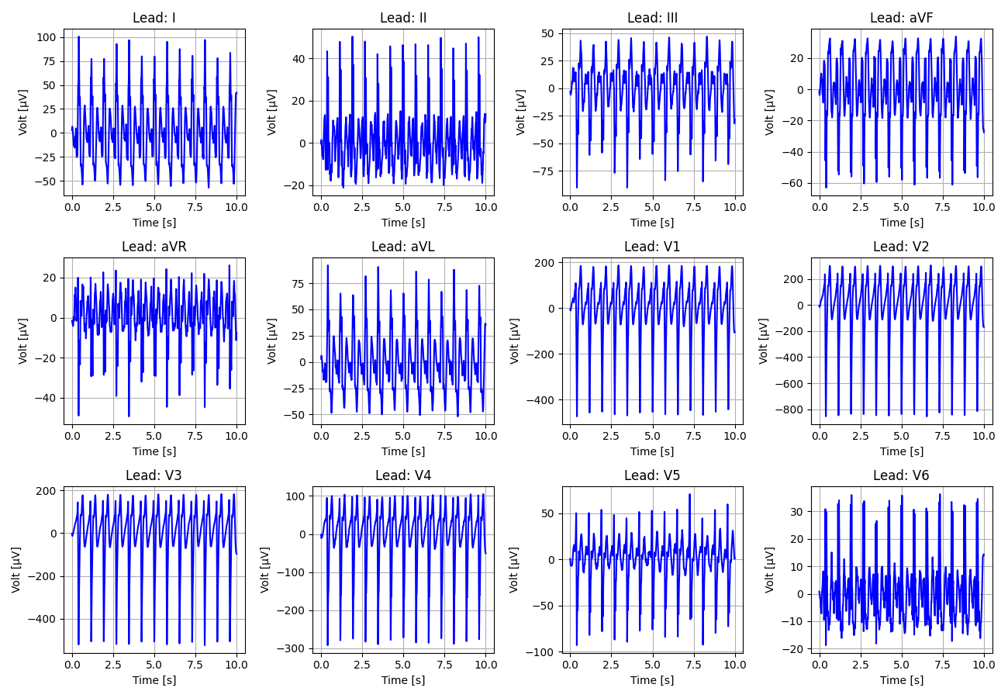
30_Recording_1394231

Slide 31
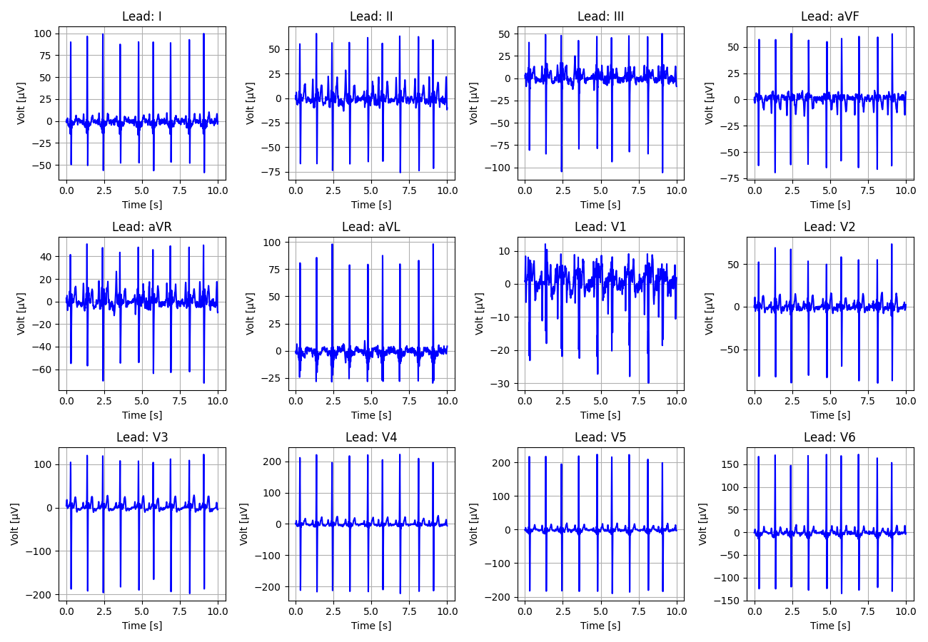
31_Recording_1232746

Slide 32
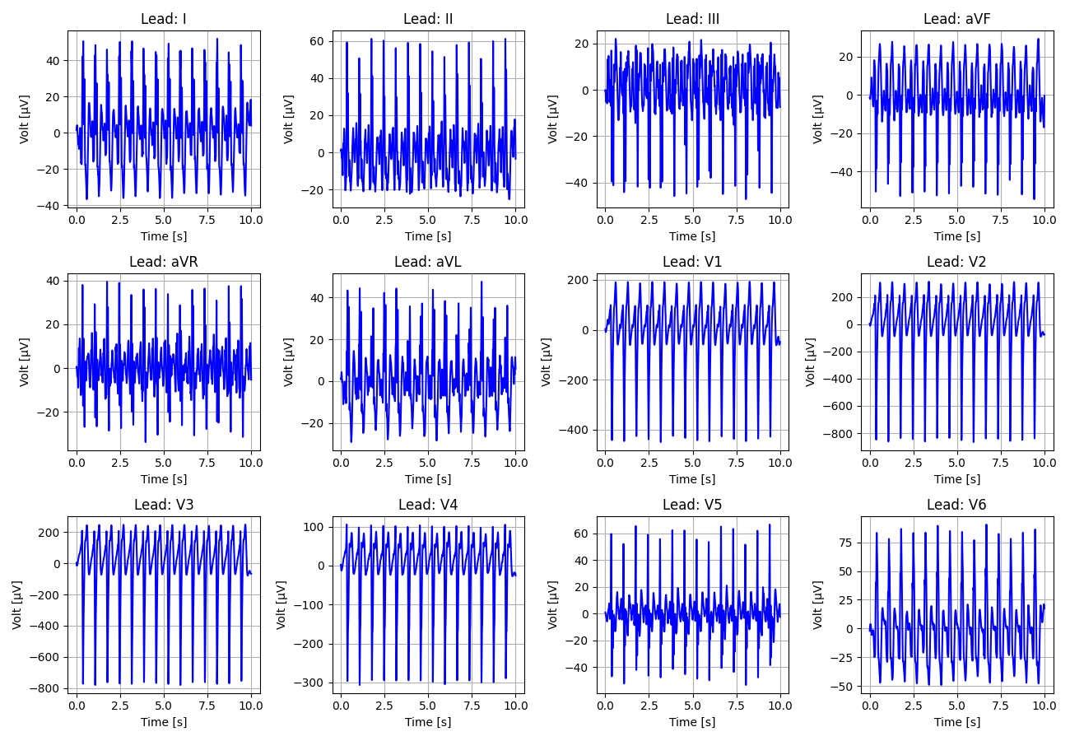
32_Recording_2301647

Slide 33
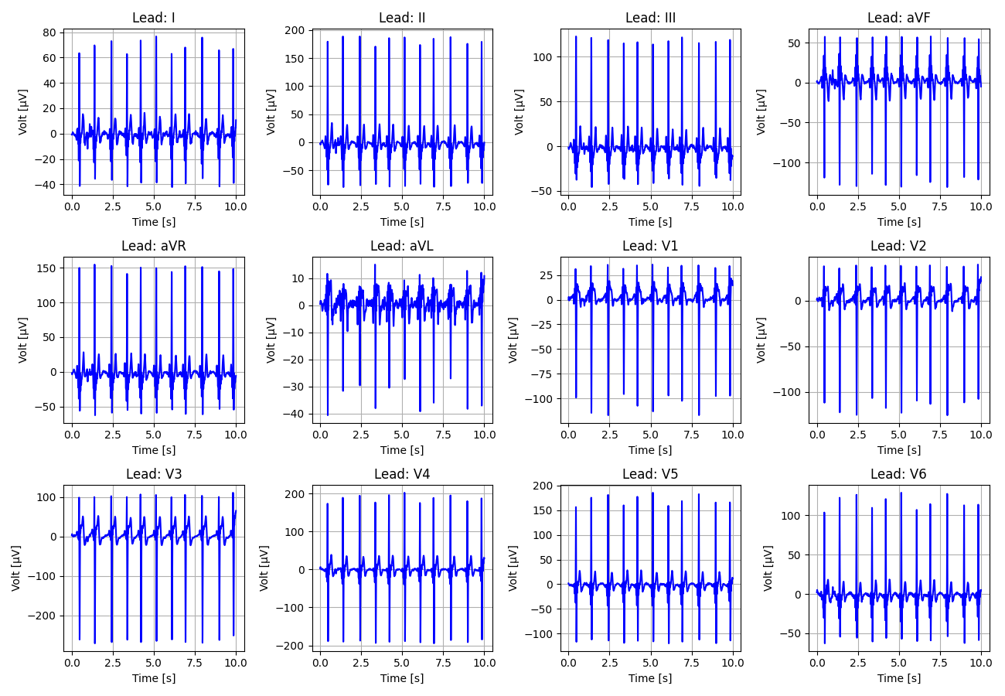
33_Recording_2934316

Slide 34
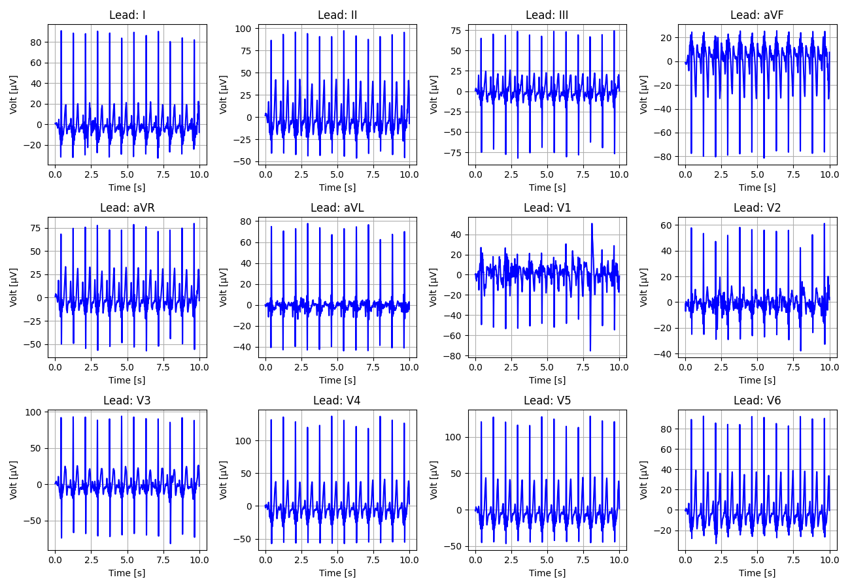
34_Recording_1363100

Slide 35
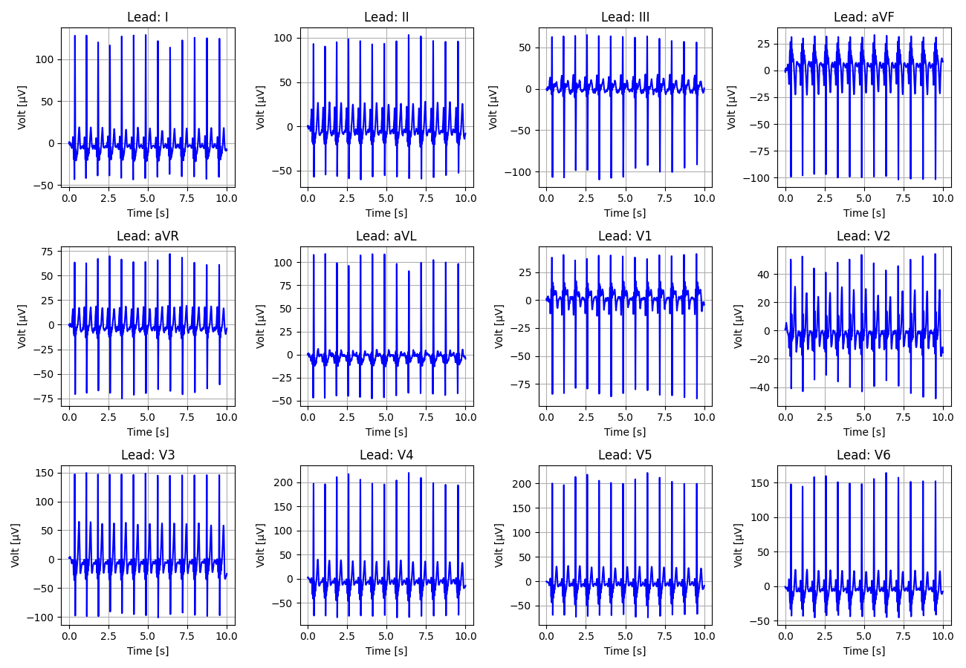
35_Recording_1165660

Slide 36
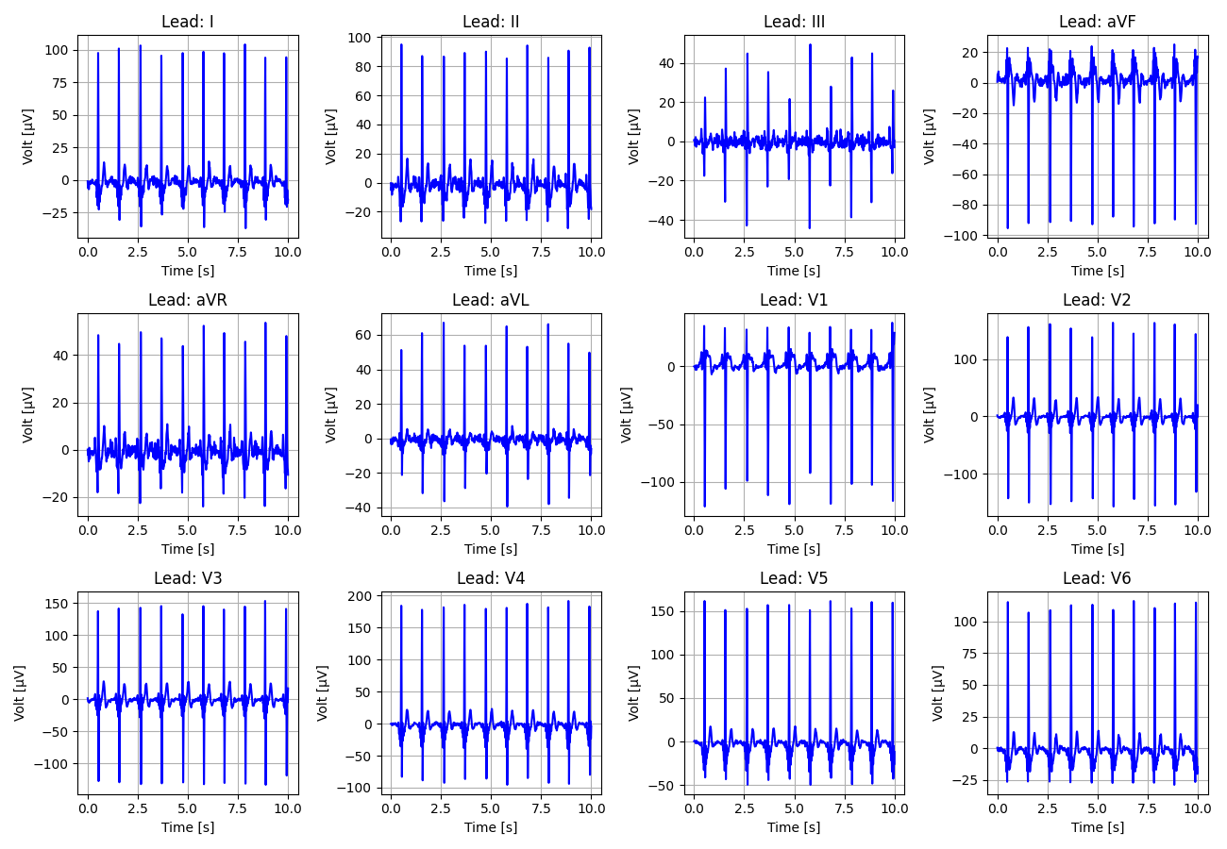
36_Recording_1146503

Slide 37
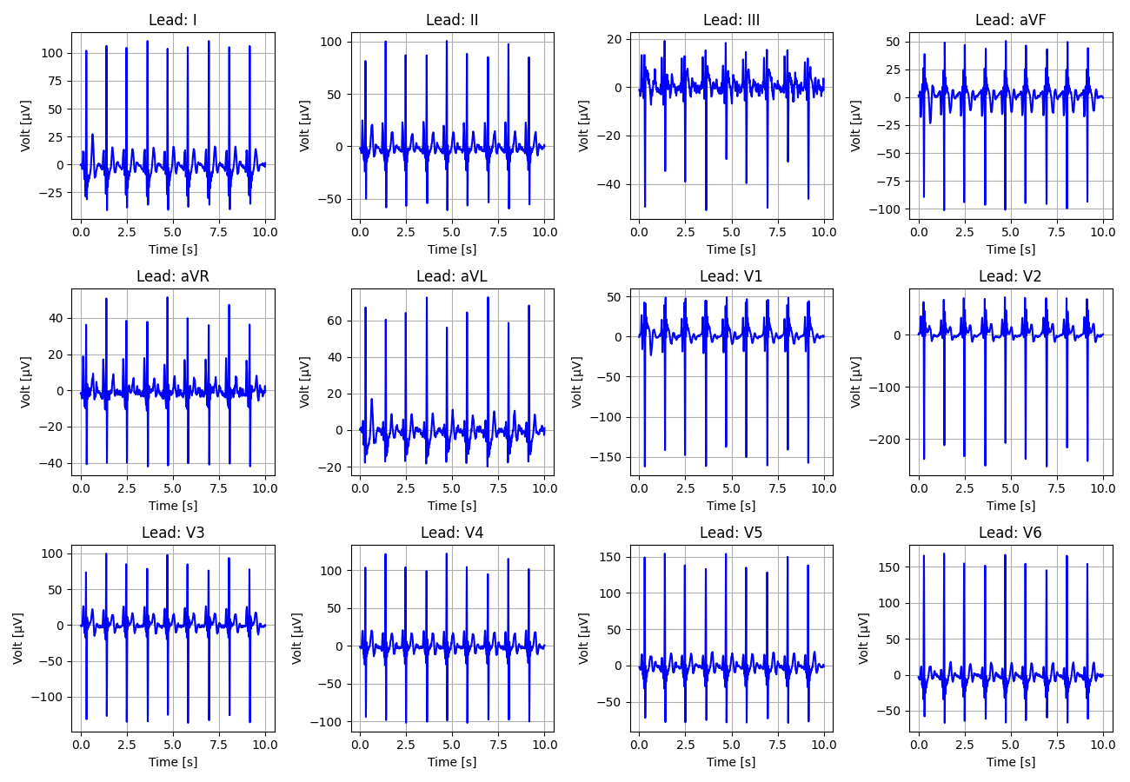
37_Recording_2388751

Slide 38
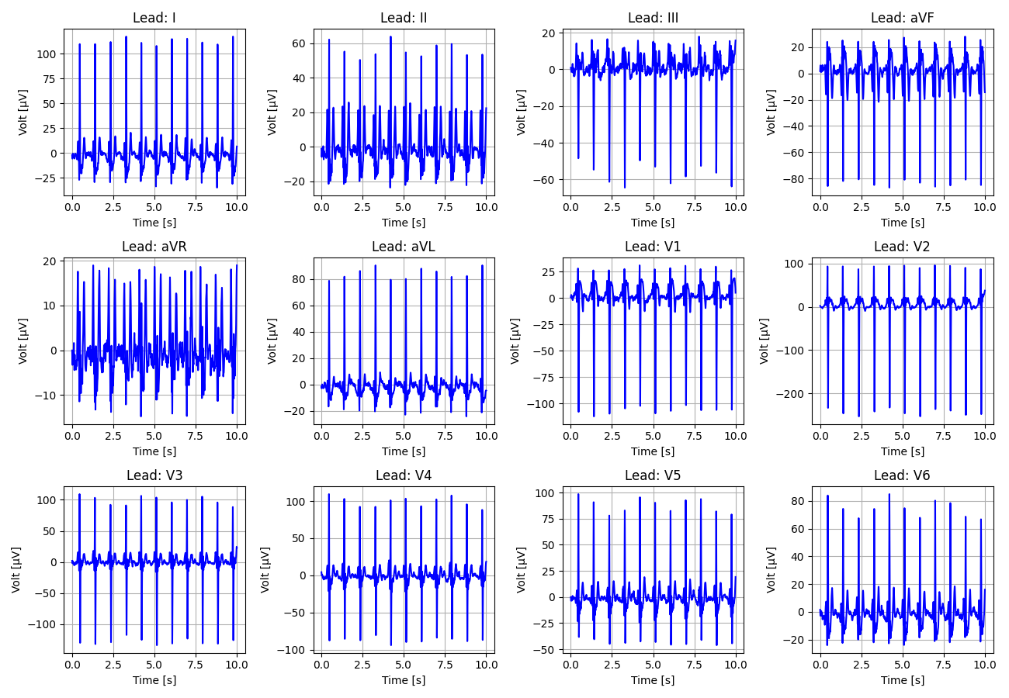
38_Recording_1133939

Slide 39
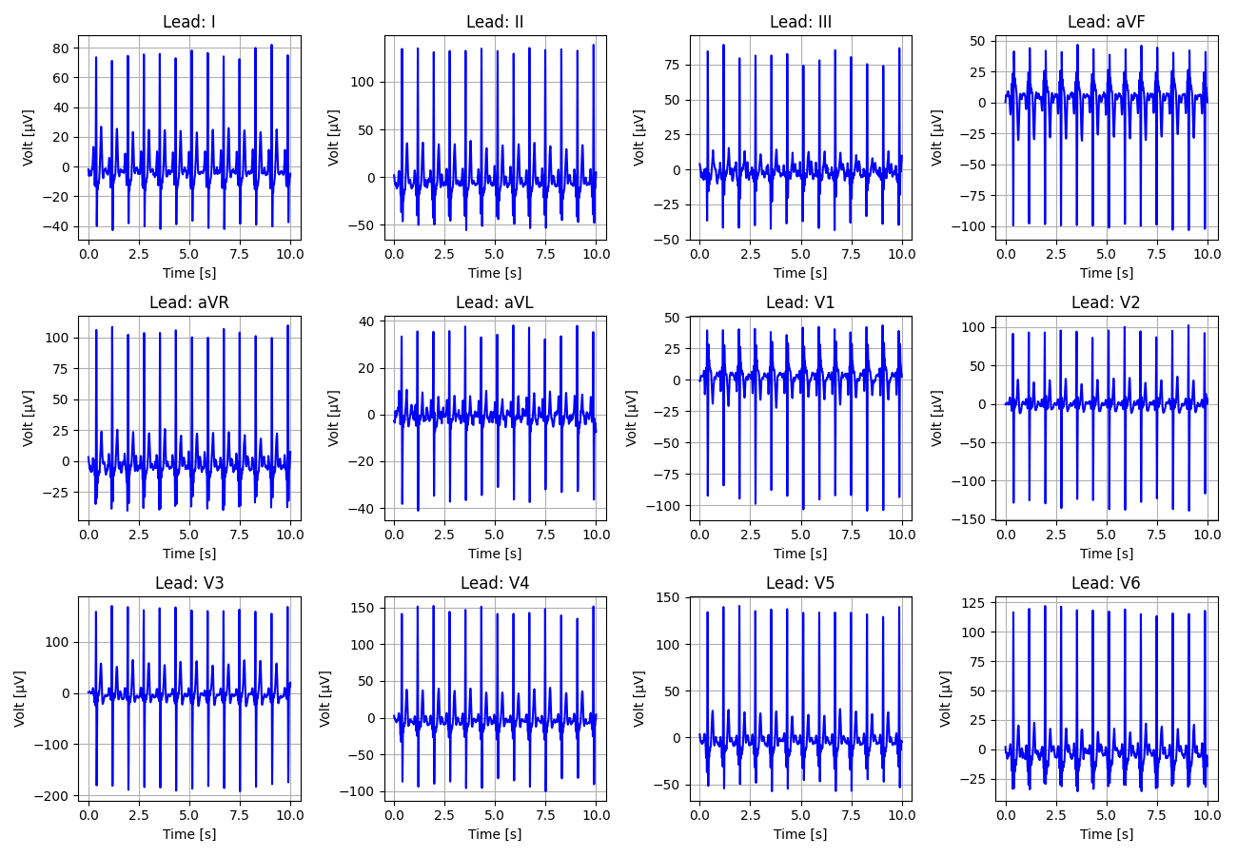
39_Recording_1168914

Slide 40
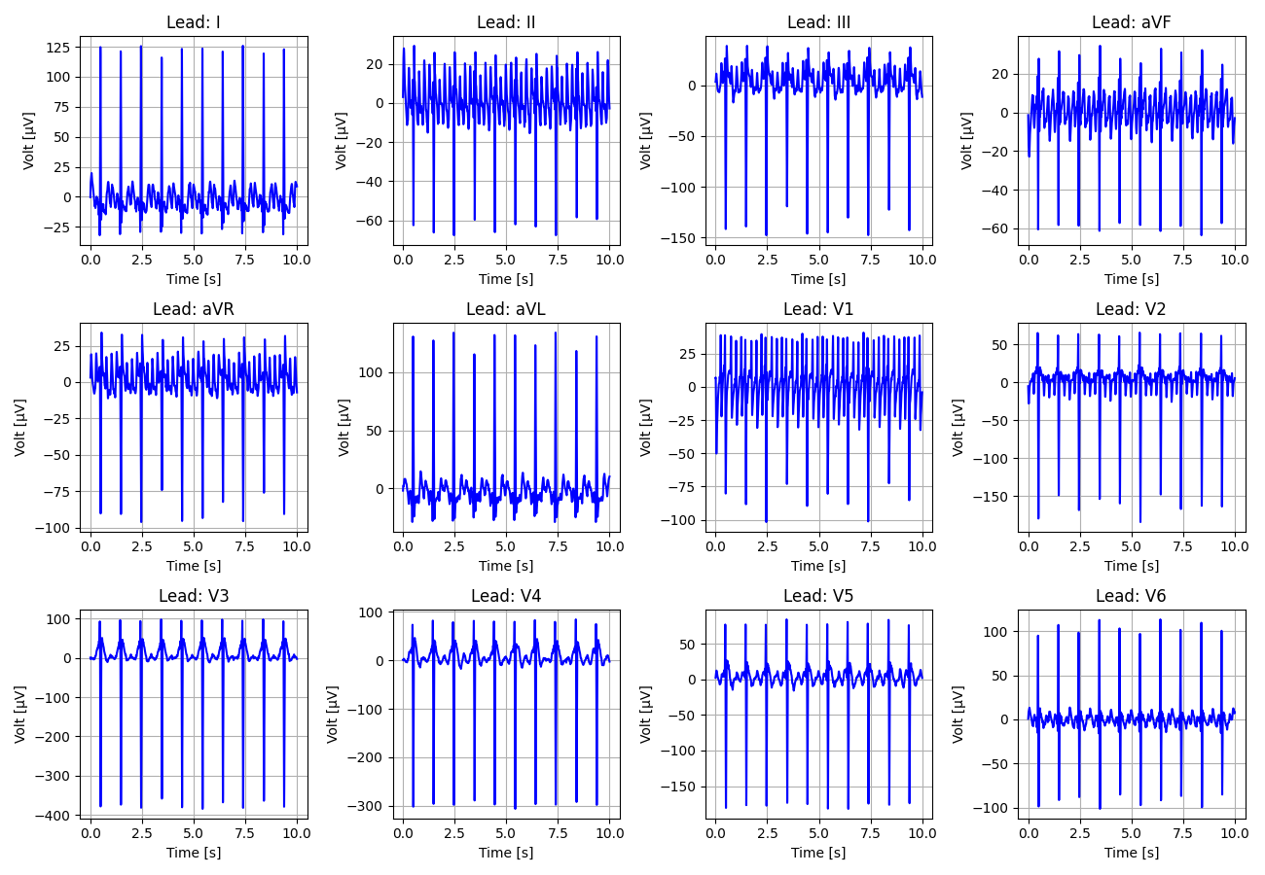
40_Recording_2429191

Slide 41
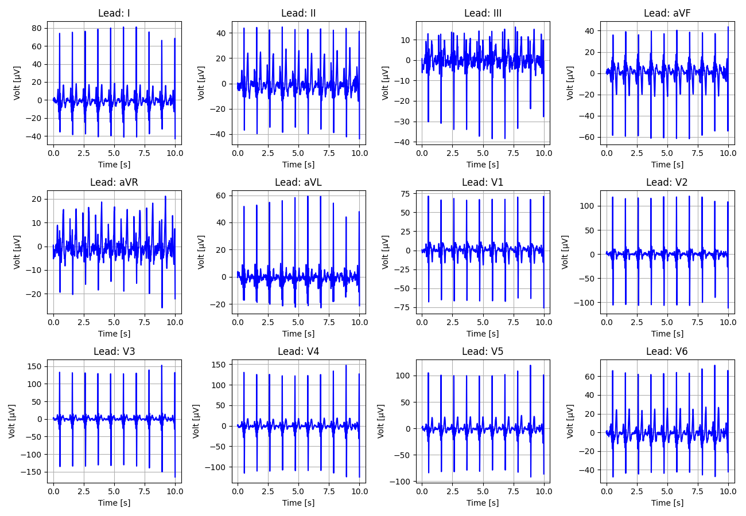
41_Recording_2108482

Slide 42
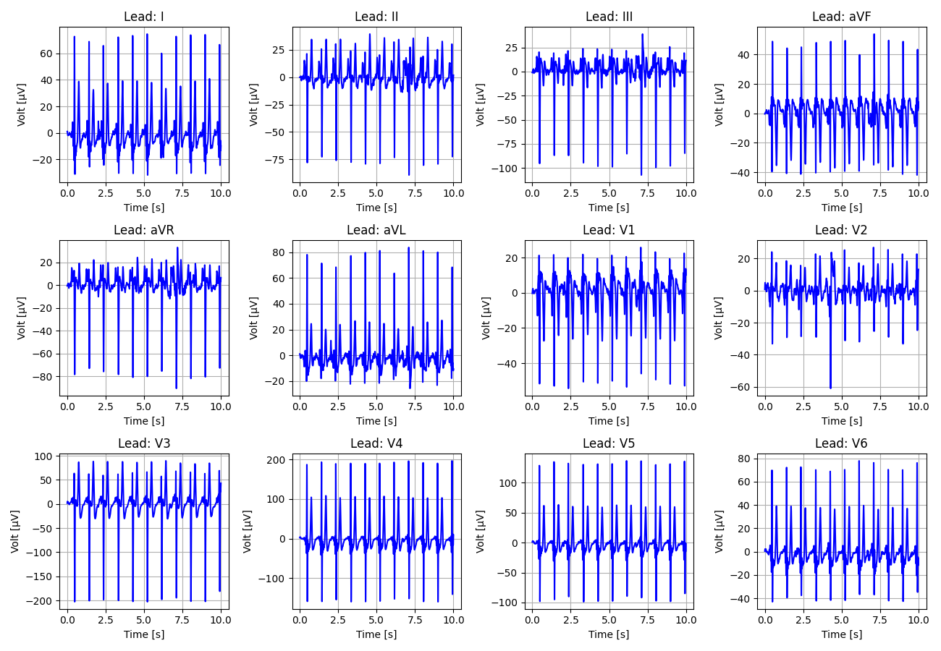
42_Recording_1224250

Slide 43
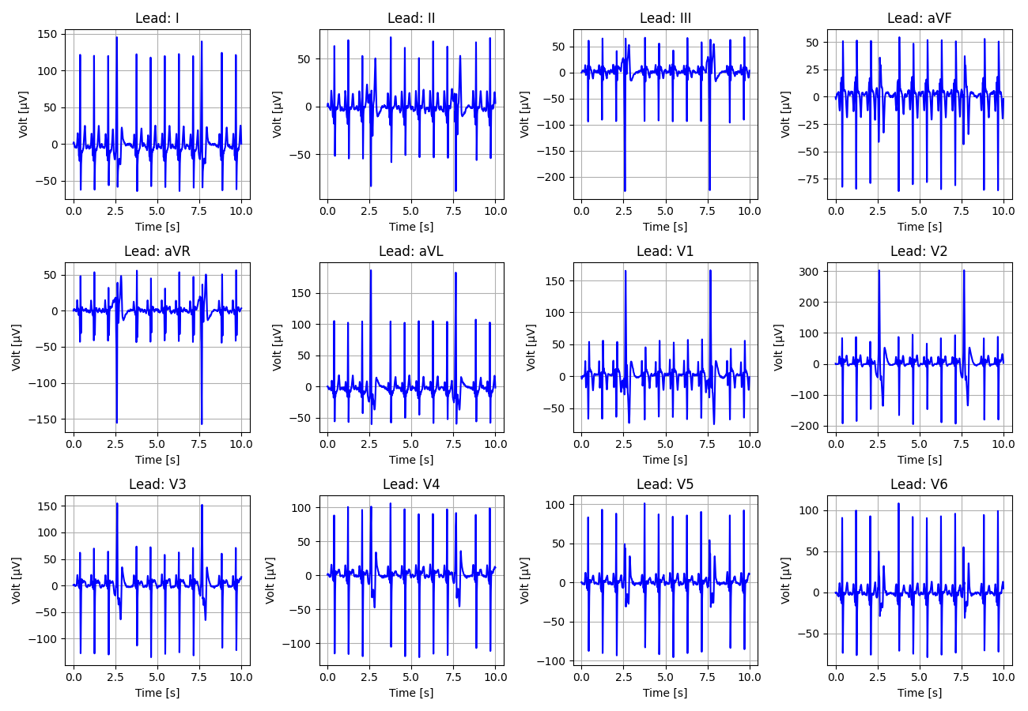
43_Recording_2627461

Slide 44
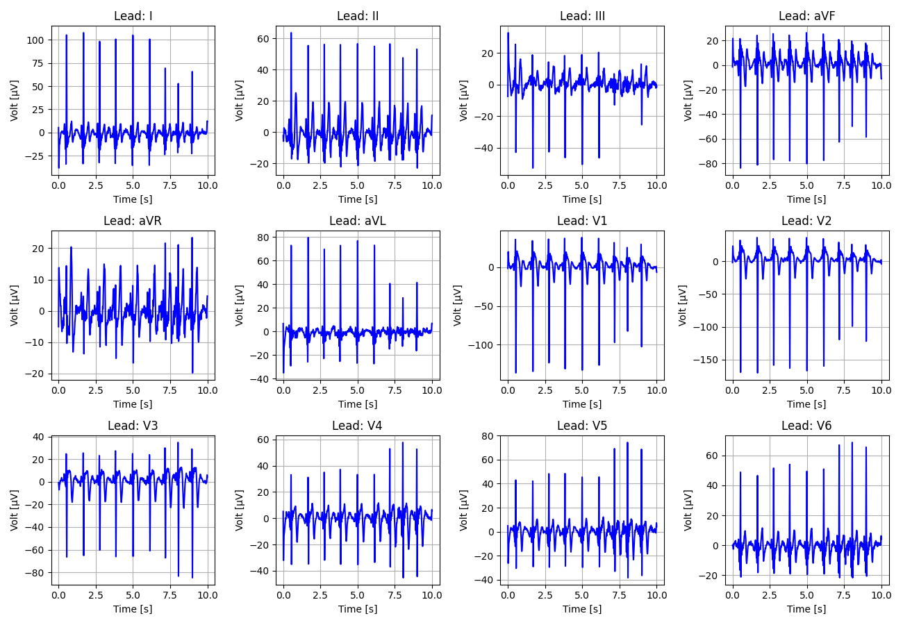
44_Recording_2176325

Slide 45
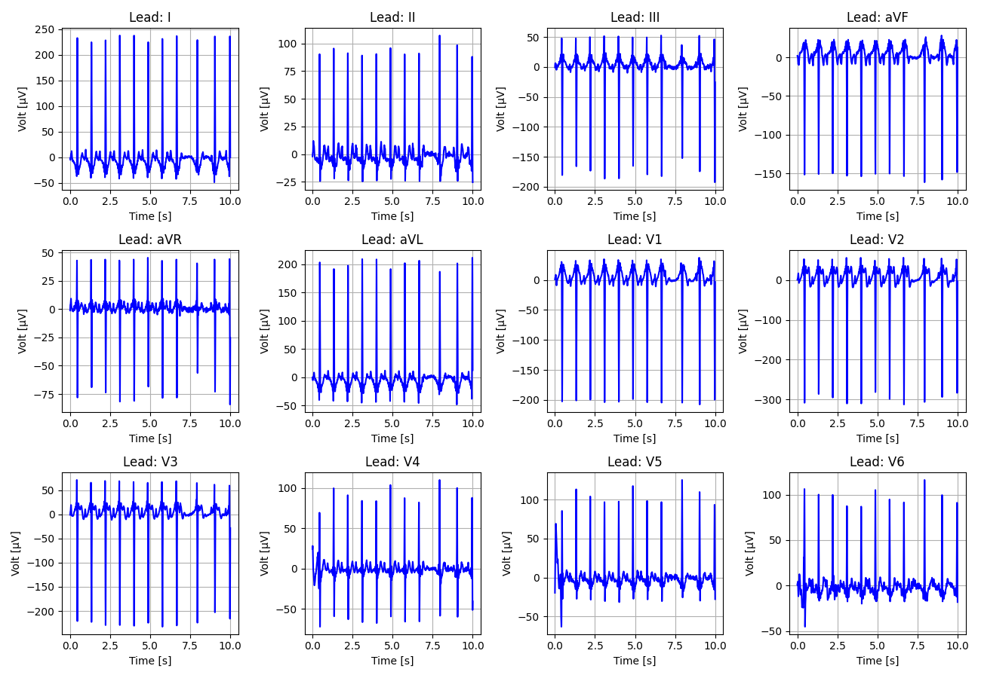
45_Recording_2804853

Slide 46
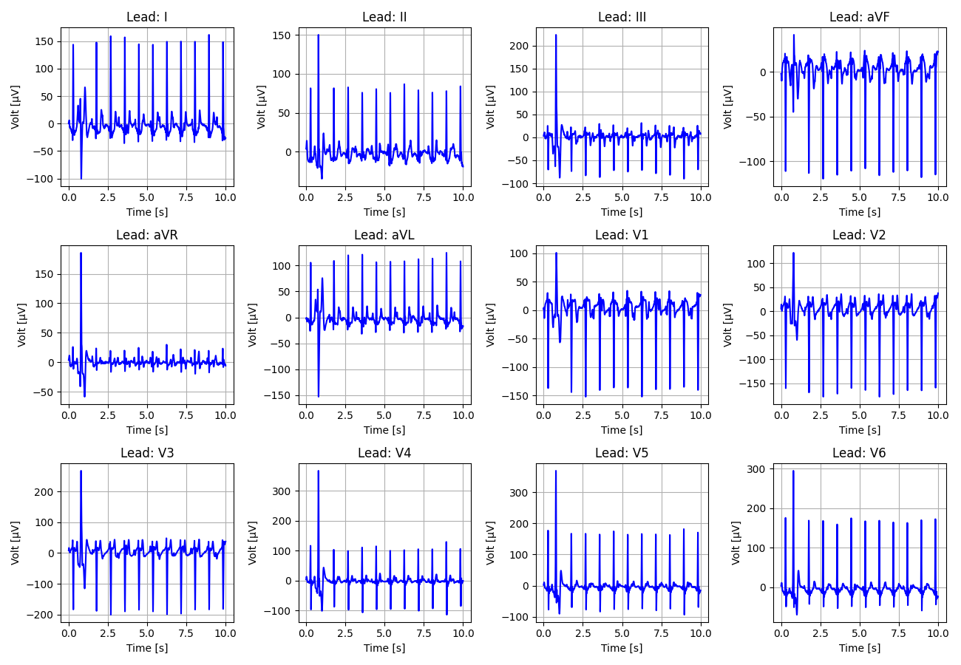
46_Recording_2081656

Slide 47
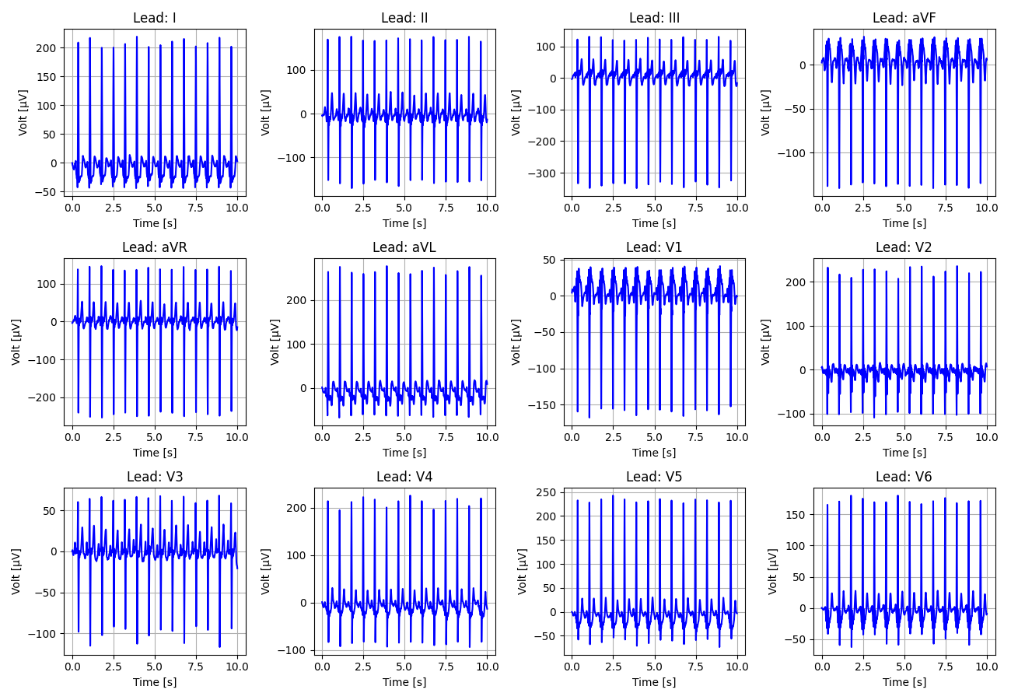
47_Recording_1185077

Slide 48
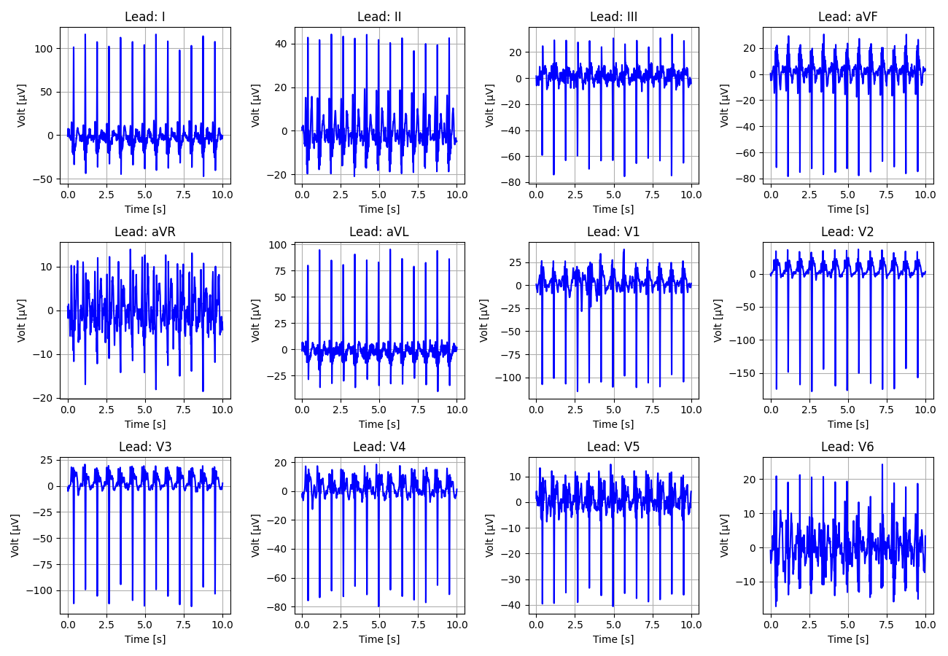
48_Recording_2580428

Slide 49
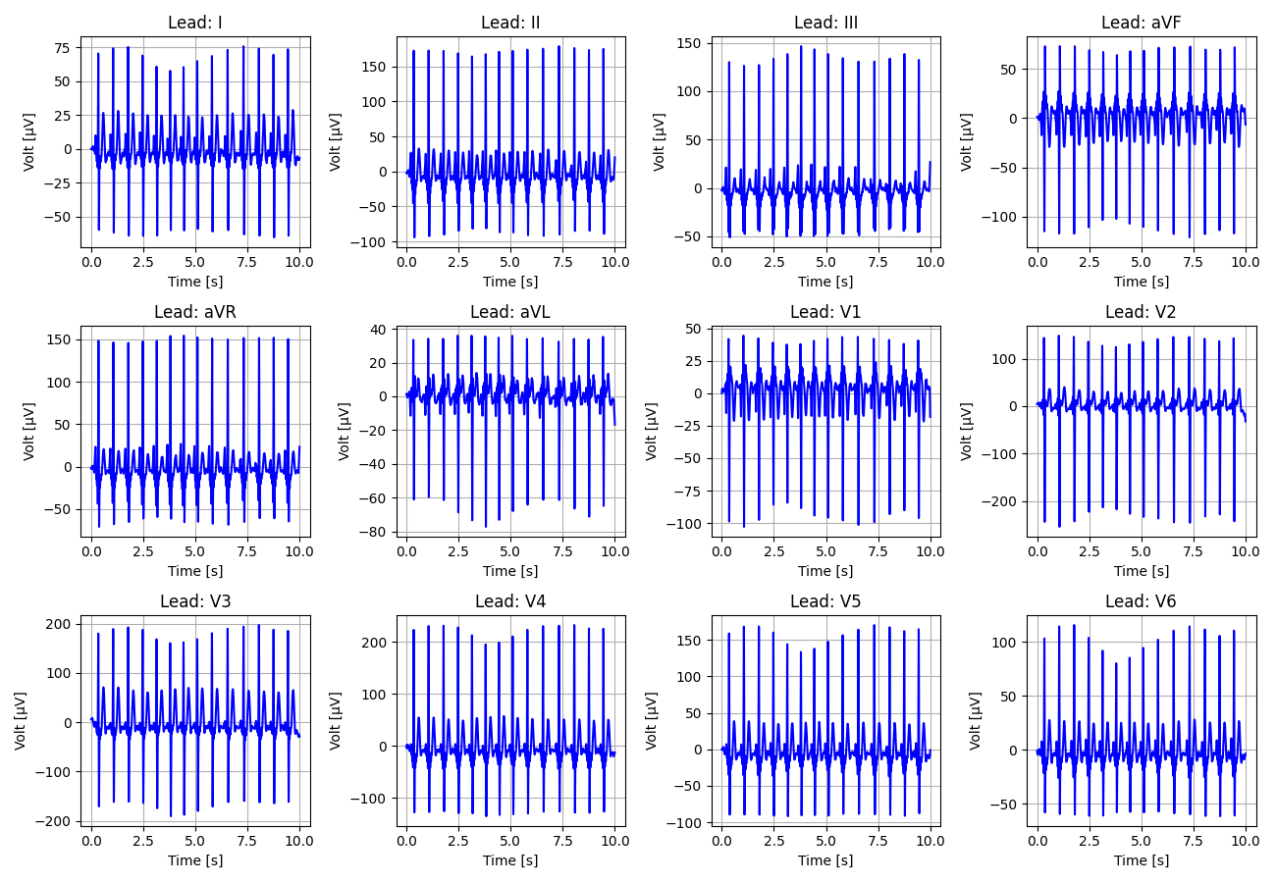
49_Recording_2128145

Slide 50
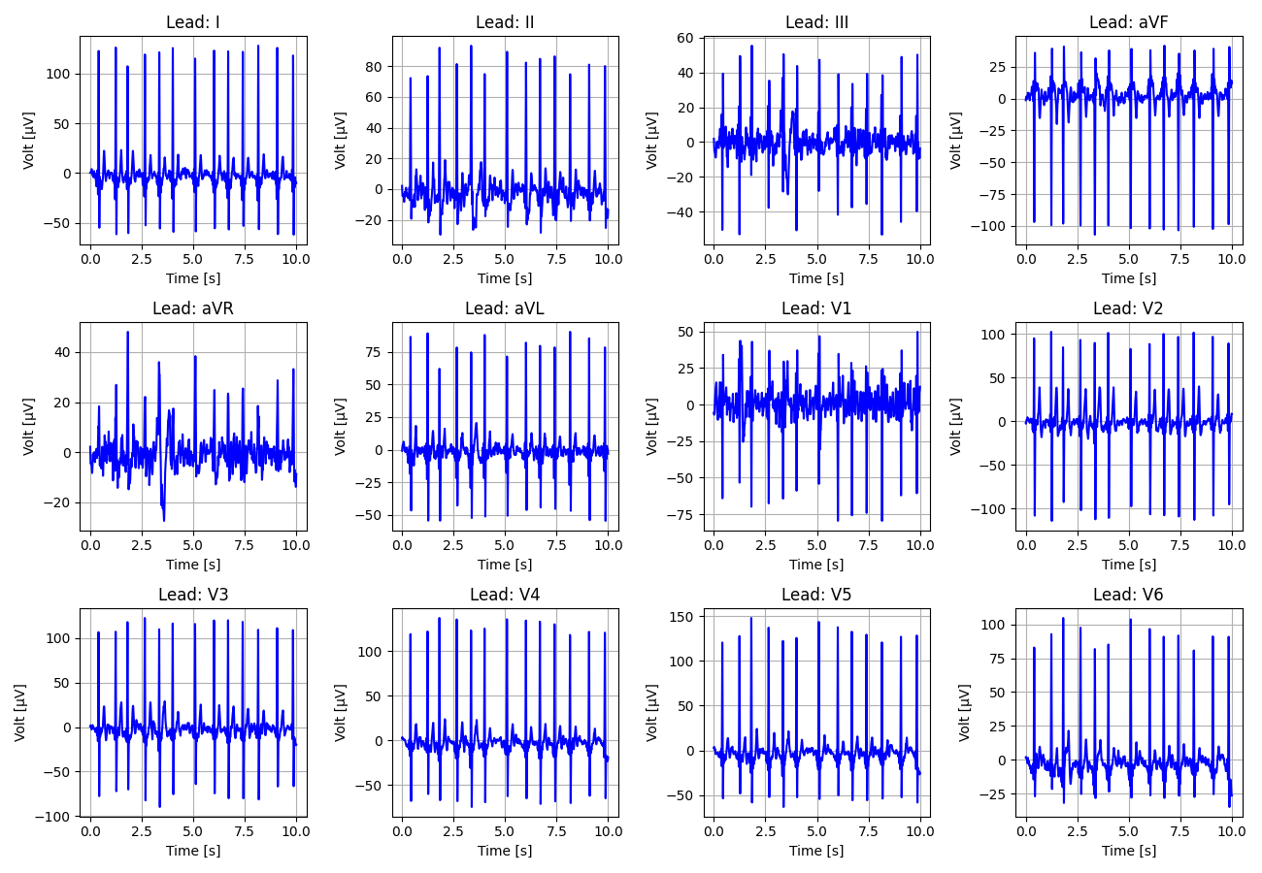
50_Recording_2514603

Slide 51

51_Recording_1379675

Slide 52

52_Recording_2552850

Slide 53

53_Recording_1102129

Slide 54

54_Recording_1952013

Slide 55

55_Recording_2502698

Slide 56

56_Recording_1624761

Slide 57

57_Recording_2409959

Slide 58

58_Recording_1027294

Slide 59

59_Recording_1350943

Slide 60

60_Recording_2988640

Slide 61

61_Recording_2880840

Slide 62

62_Recording_2064122

Slide 63

63_Recording_2090560

Slide 64

64_Recording_1806299

Slide 65

65_Recording_2371170

Slide 66

66_Recording_2825450

Slide 67

67_Recording_1344909

Slide 68

68_Recording_2789383

Slide 69

69_Recording_2220115

Slide 70

70_Recording_1959699

Slide 71

71_Recording_1354128

Slide 72

72_Recording_1295971

Slide 73

73_Recording_1053871

Slide 74

74_Recording_1636043

Slide 75

75_Recording_1124627

Slide 76

76_Recording_2610344

Slide 77

77_Recording_1770296

Slide 78

78_Recording_2419141

Slide 79

79_Recording_1665193

Slide 80

80_Recording_1176338

Slide 81

81_Recording_2918084

Slide 82

82_Recording_1937641

Slide 83

83_Recording_1066648

Slide 84

84_Recording_2148930

Slide 85

85_Recording_2127352

Slide 86

86_Recording_2037566

Slide 87

87_Recording_1452994

Slide 88

88_Recording_2183949

Slide 89

89_Recording_2568209

Slide 90

90_Recording_2319354

Slide 91

91_Recording_1108131

Slide 92

92_Recording_1102445

Slide 93

93_Recording_2926949

Slide 94

94_Recording_2959985

Slide 95

95_Recording_2002988

Slide 96

96_Recording_1738541

Slide 97

97_Recording_2454325

Slide 98

98_Recording_2070076

Slide 99

99_Recording_2647986

Slide 100

100_Recording_2362692

